Slide 1
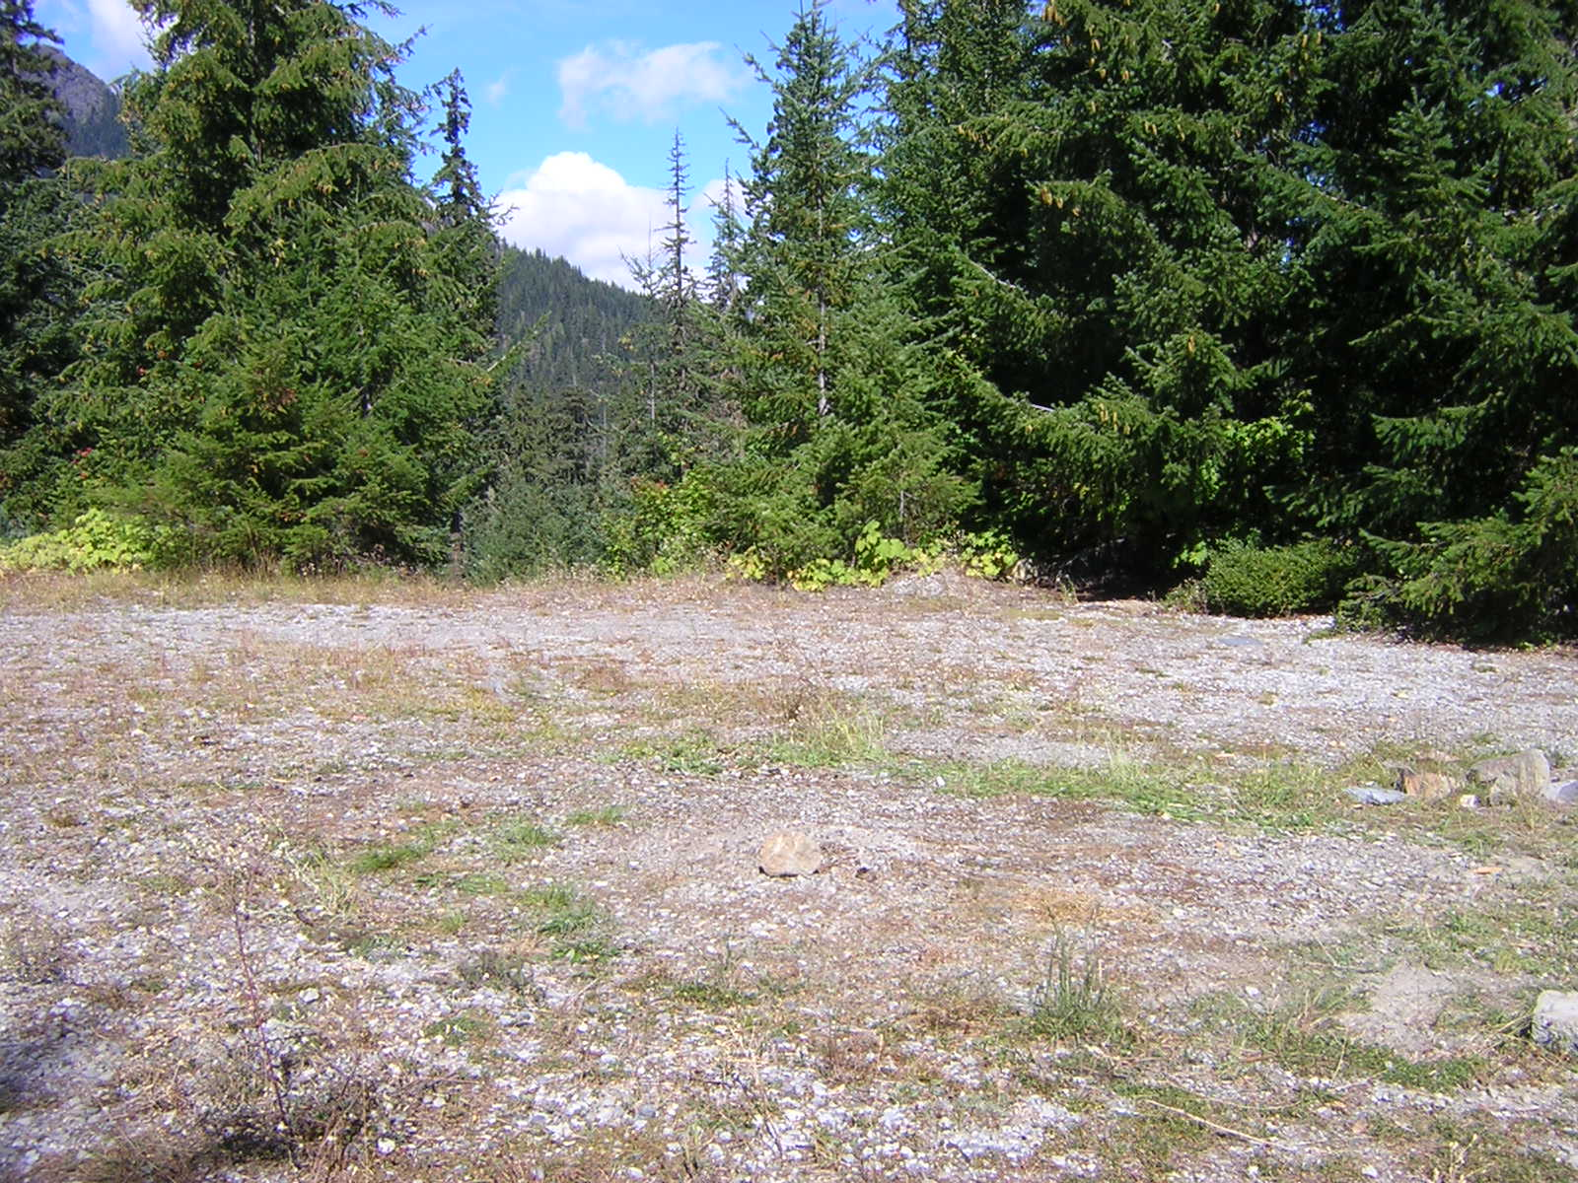

FRIENDS OF THE TRAIL
A nonprofit organization dedicated to cleaning up Washington’s public lands and waterways
PO Box 1124
North Bend, WA 98045
Phone/Fax: 425-831-5486
Email: friendsot@comcast.net
www.friendsofthetrail.org

Slide 2
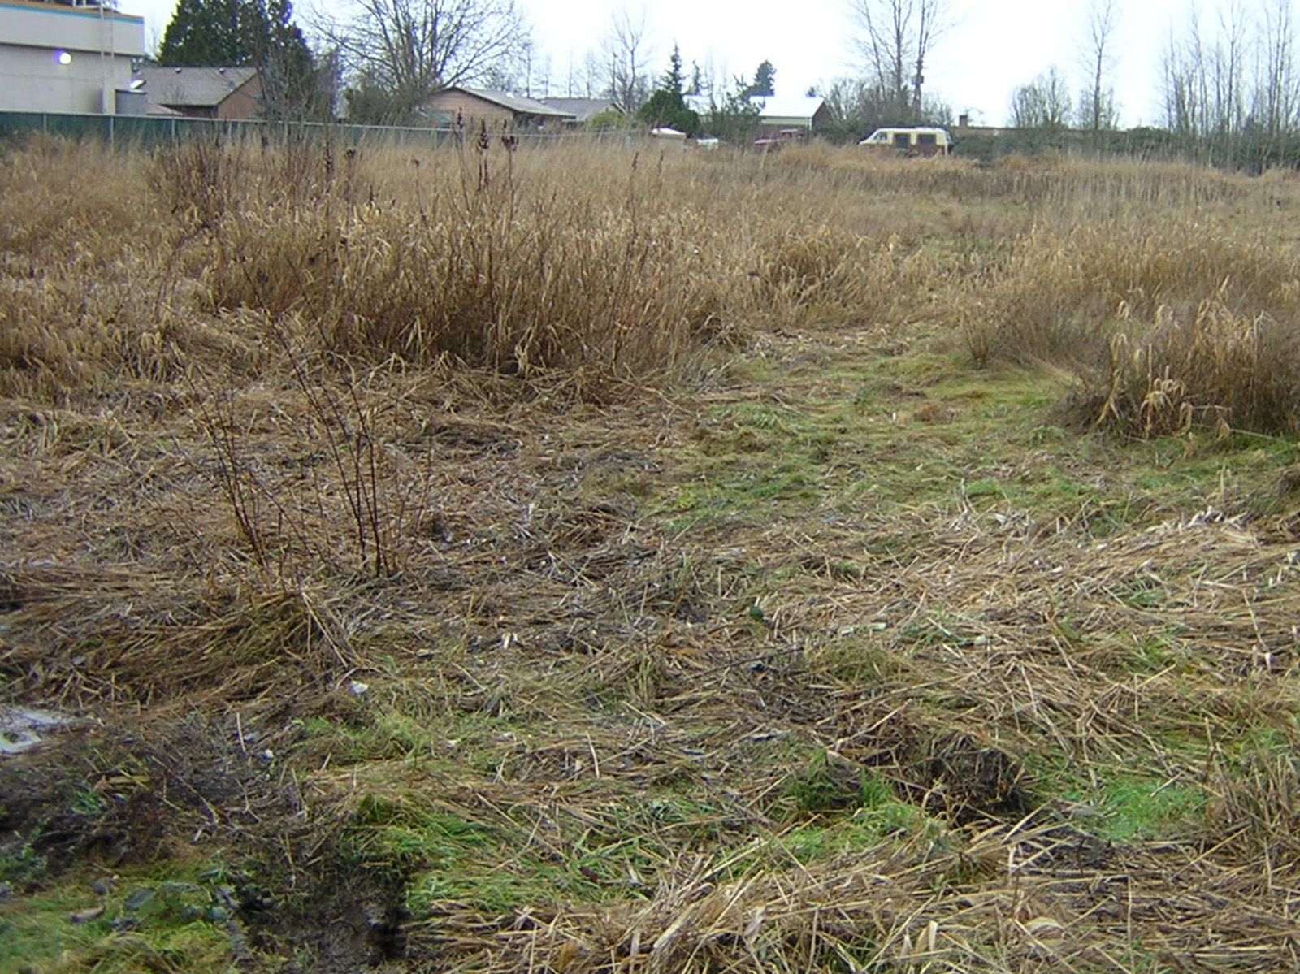
WHY ARE WE HERE?
Because all too commonly, scenes like this . . . turn into . . .

Slide 3
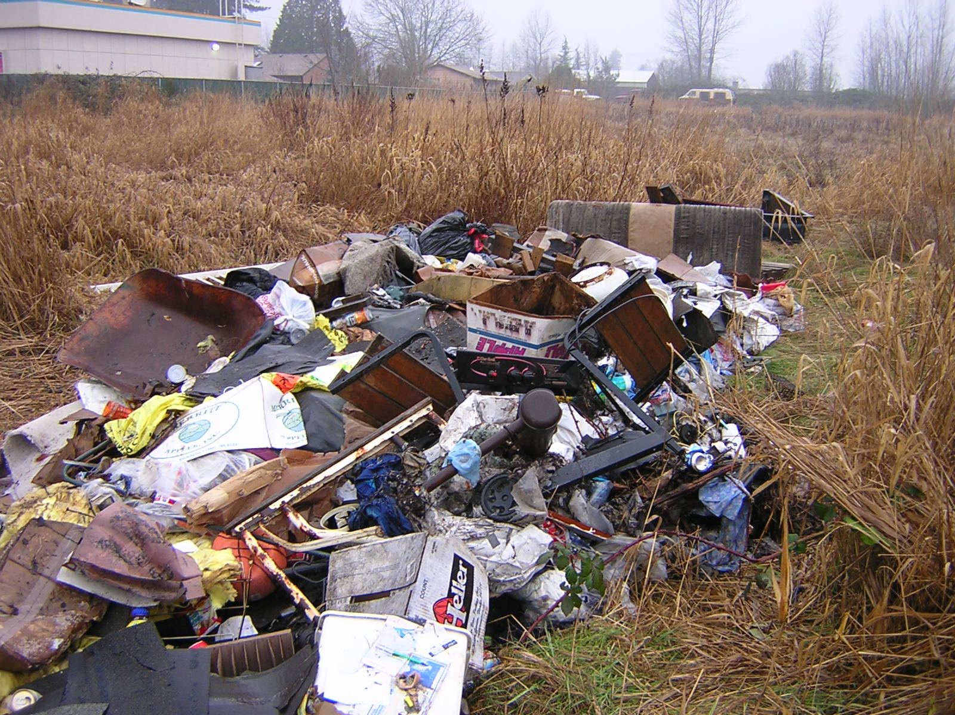
. . . this

Slide 4
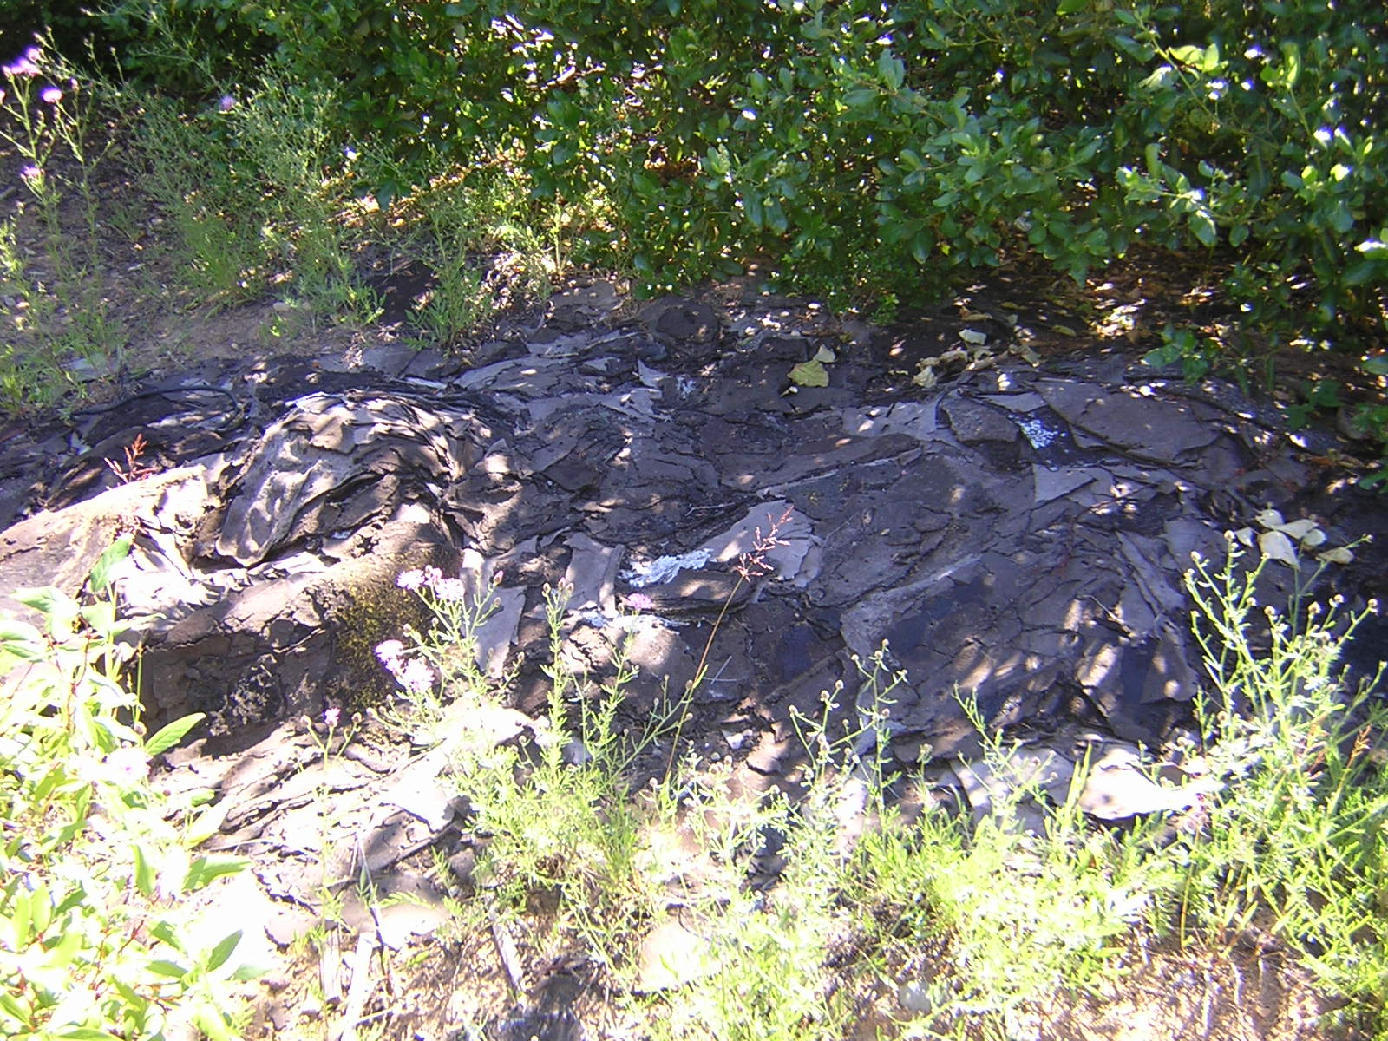
. . . this
. . . a load of roofing that would have cost several hundred dollars to dispose of legally

Slide 5
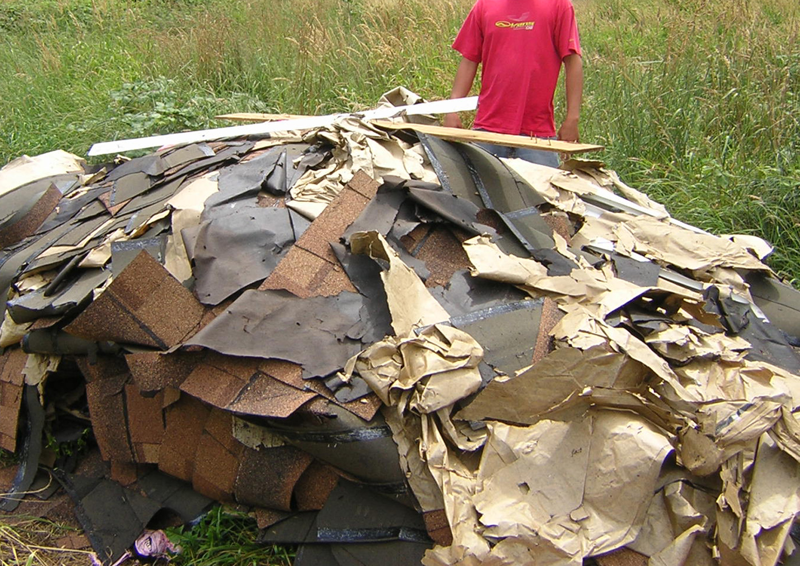
. . . a load of roofing that would have cost several hundred dollars to dispose of legally

Slide 6
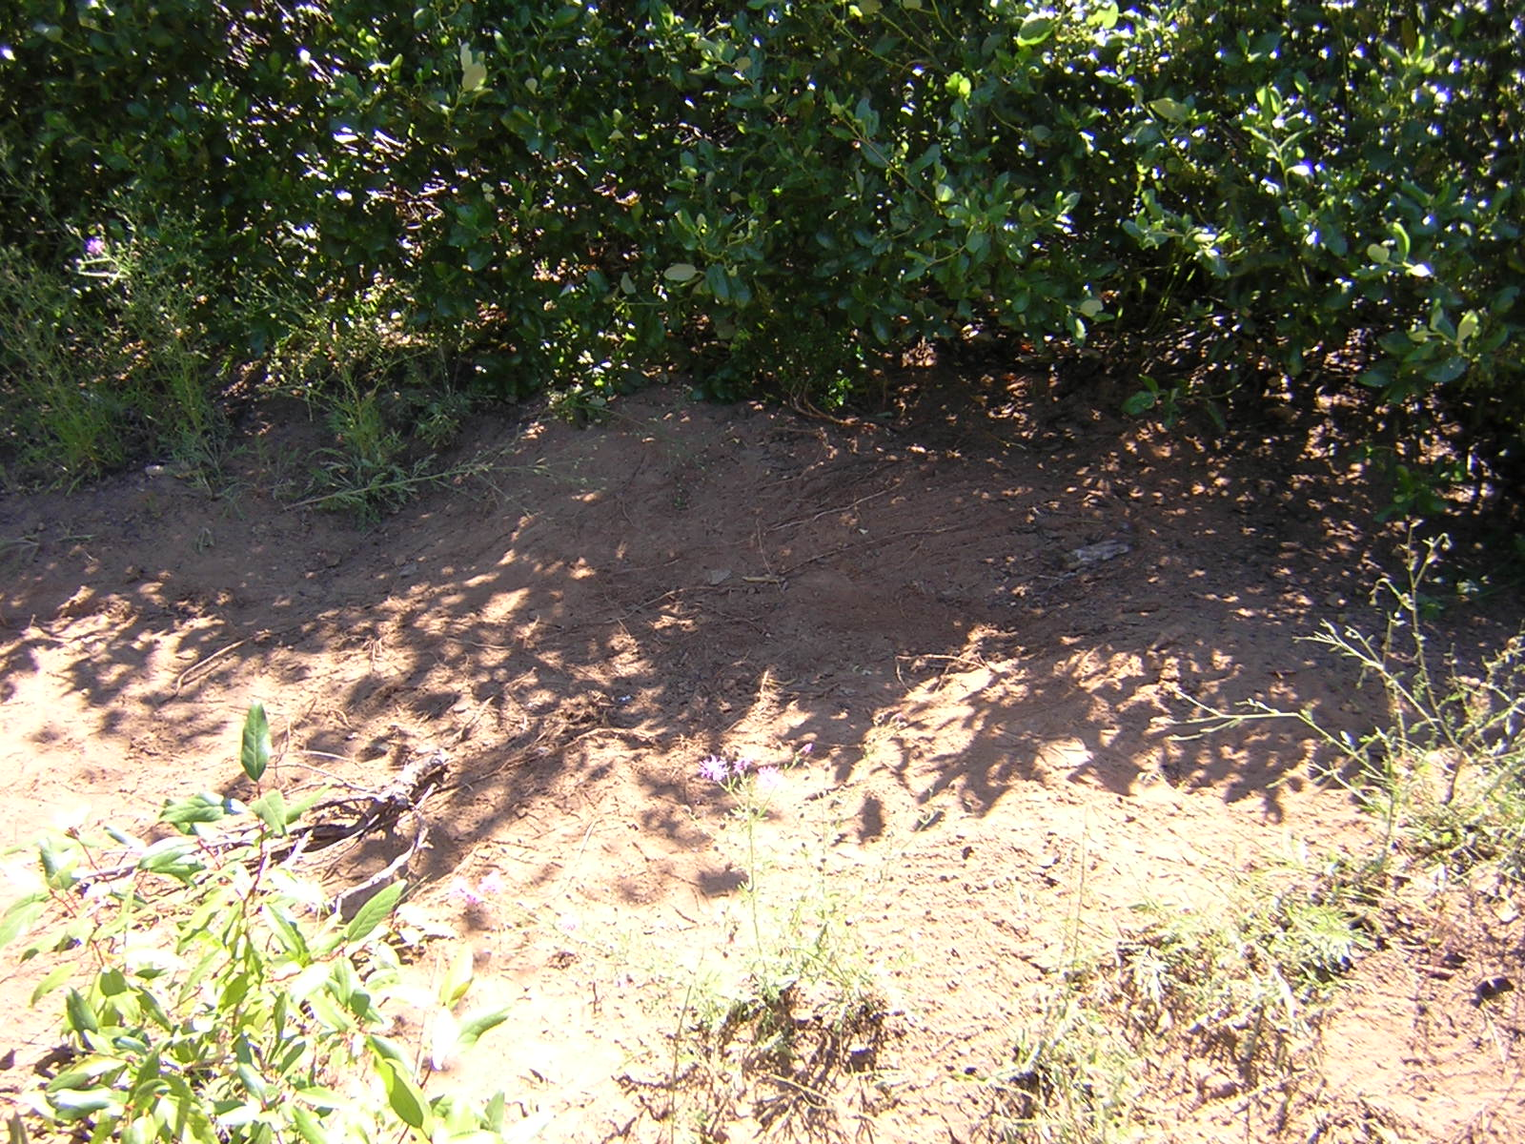
It takes less than ten seconds for this . . . to become . . .

Slide 7
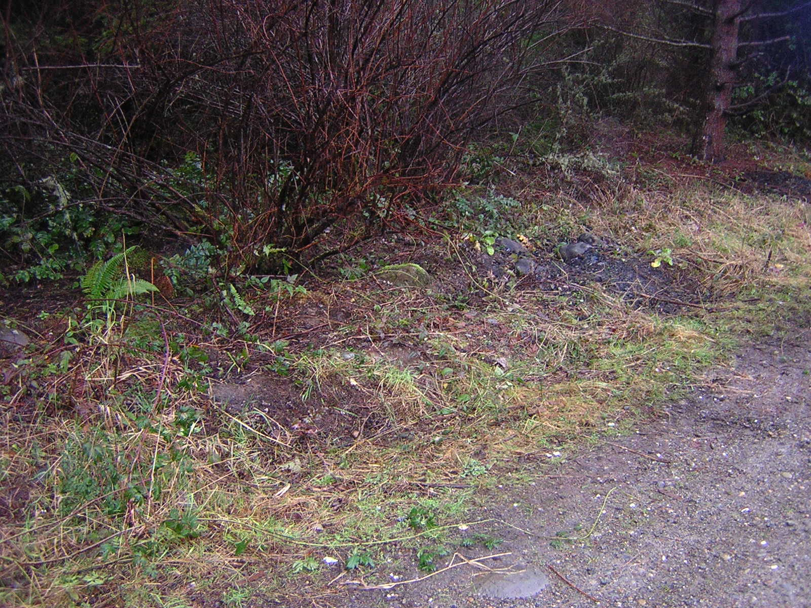
A roadside in a scenic area . . .

Slide 8
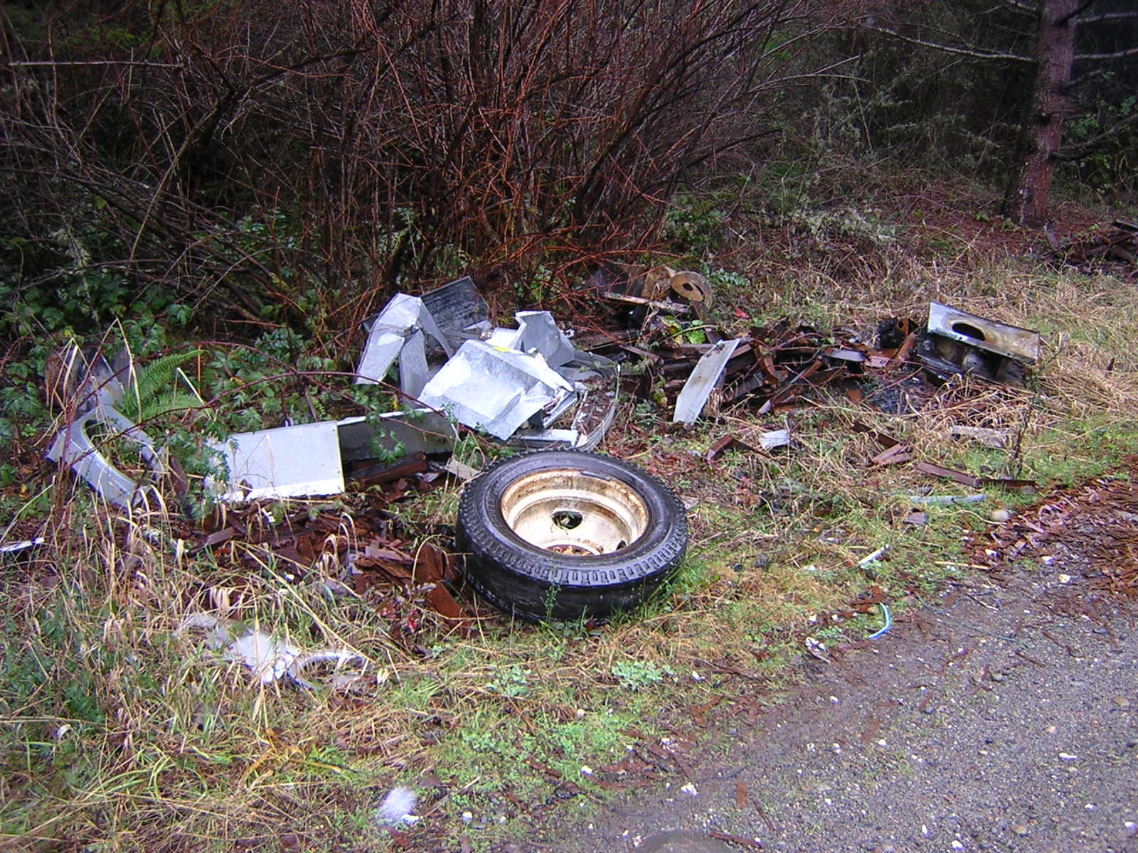
. . . gets a little trash dumped by a few thoughtless people . . .
. . . and before you know it you’ve got . . .

Slide 9
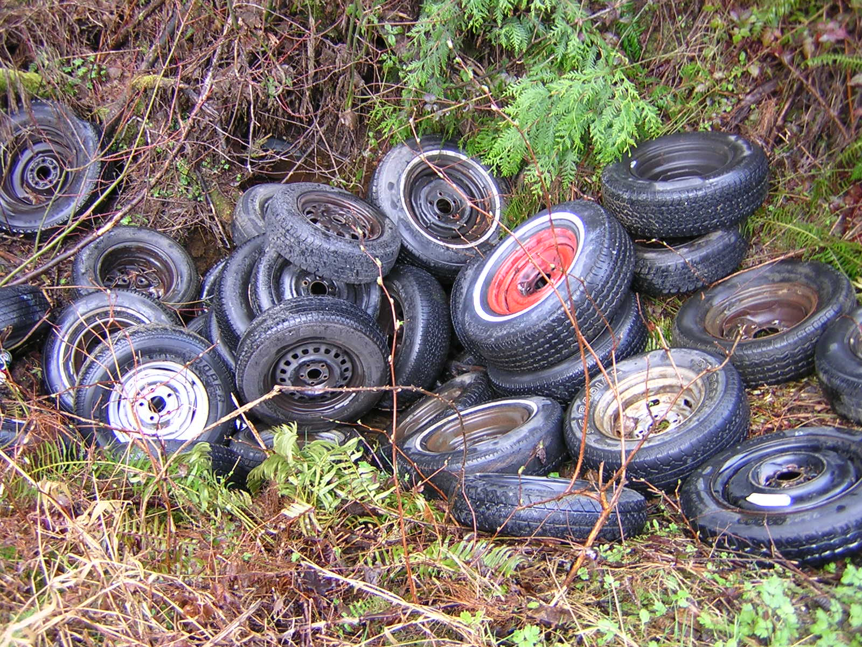
. . . this

Slide 10
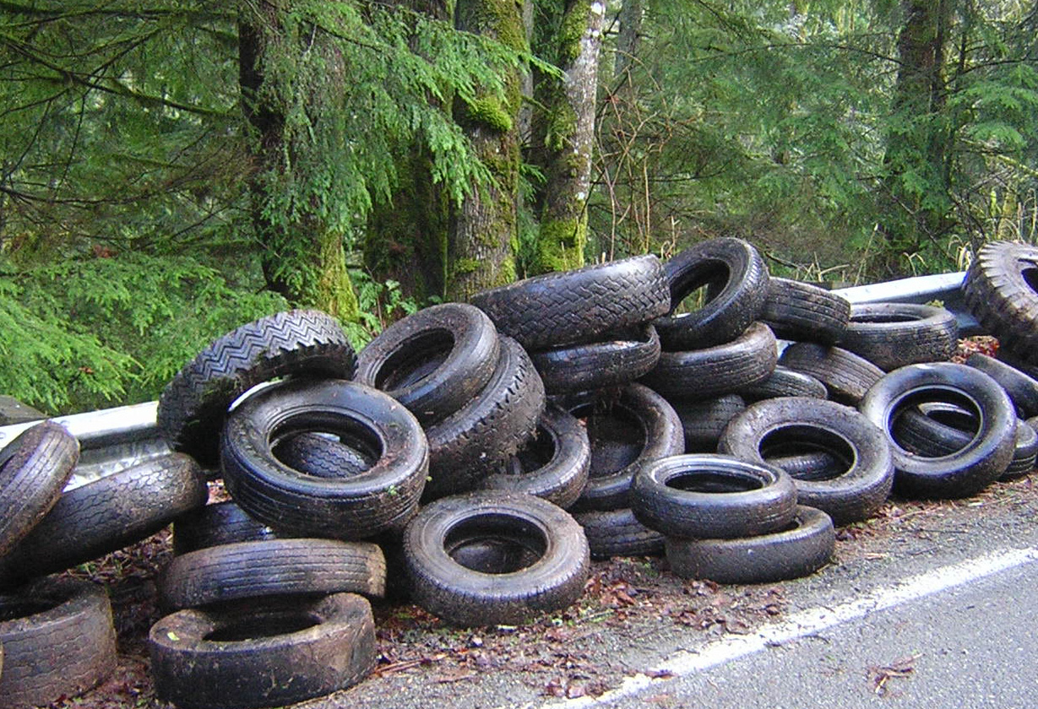
. . . this

Slide 11
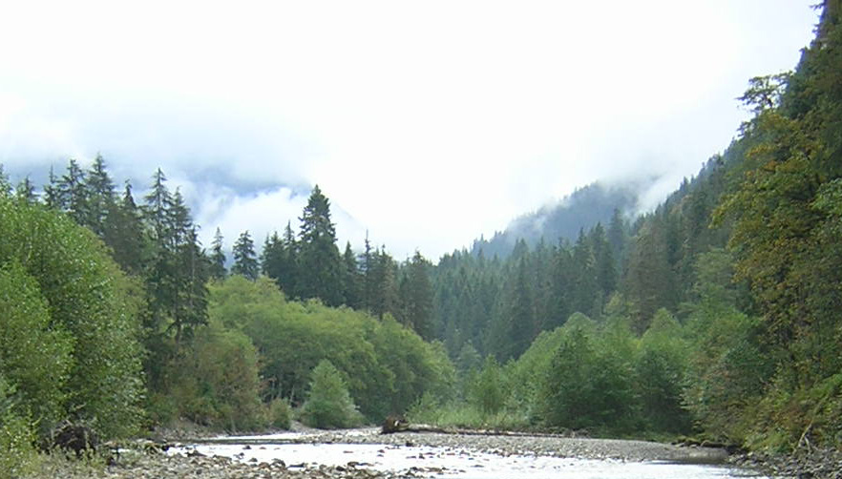
A day on the river
Enjoy Washington’s magnificent scenery . . .
Just don’t look down . . .
You might not like what you find.

Slide 12
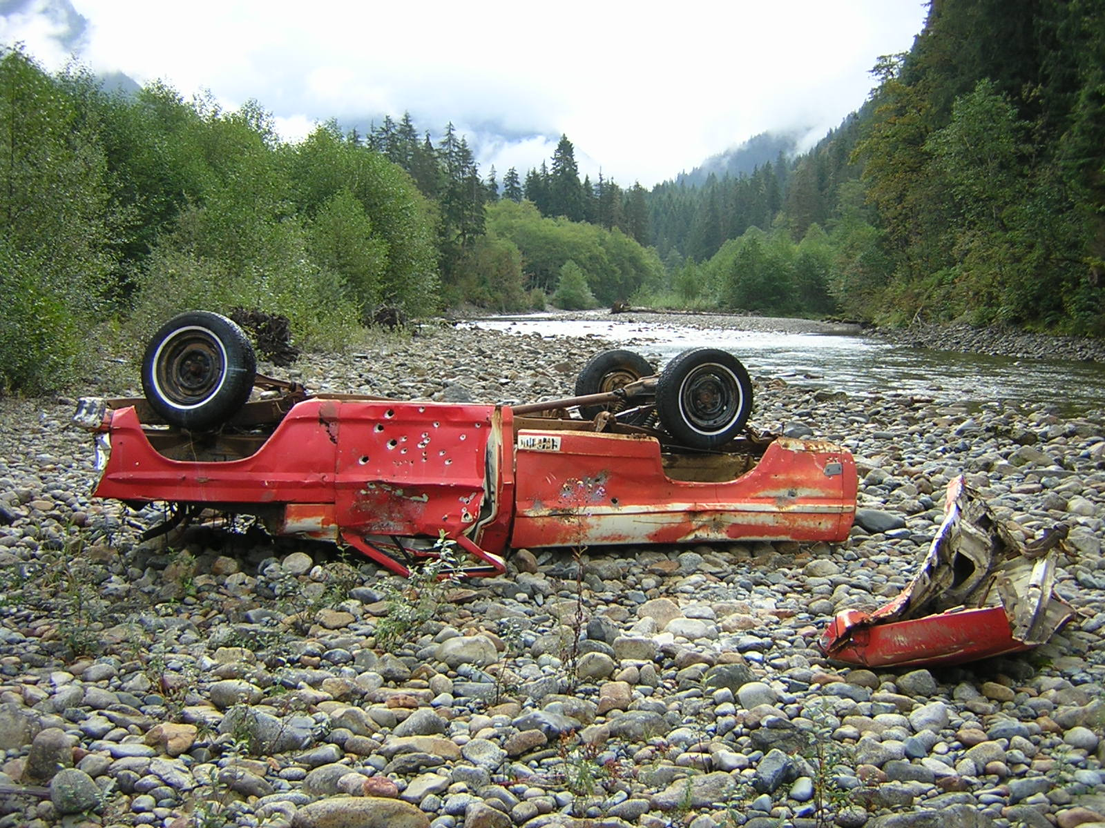
A day on the river
Enjoy Washington’s magnificent scenery . . .
Just don’t look down . . .
You might not like what you find.

Slide 13
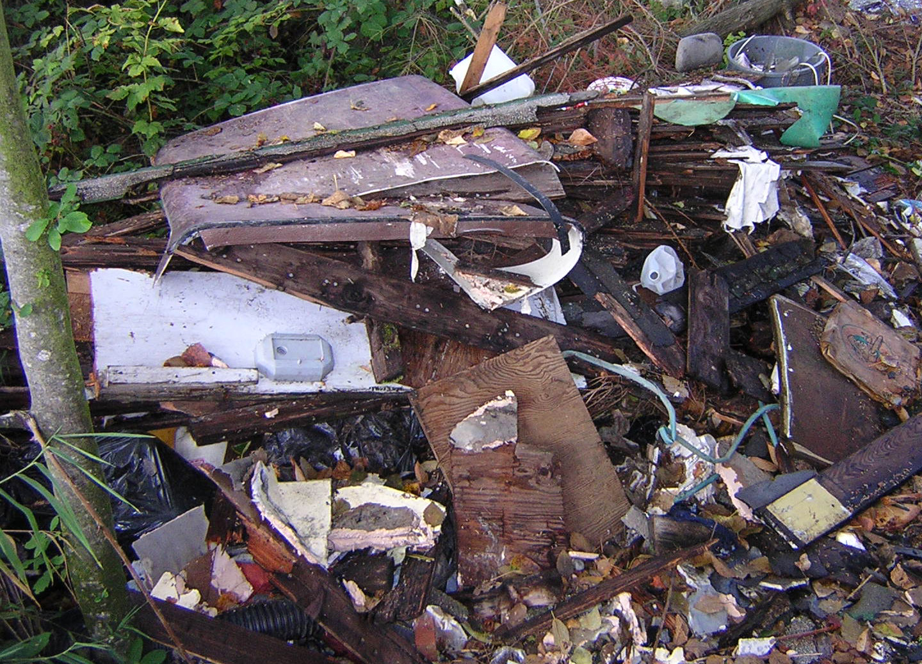
FROM A LOCAL WALKING GUIDEBOOK
“[The way] bends sharply left and a garbage-dump lane proceeds straight . . .”
“Look over the brink to a million-odd beer bottles and cans and a litter of broken cars . . .”

Slide 14
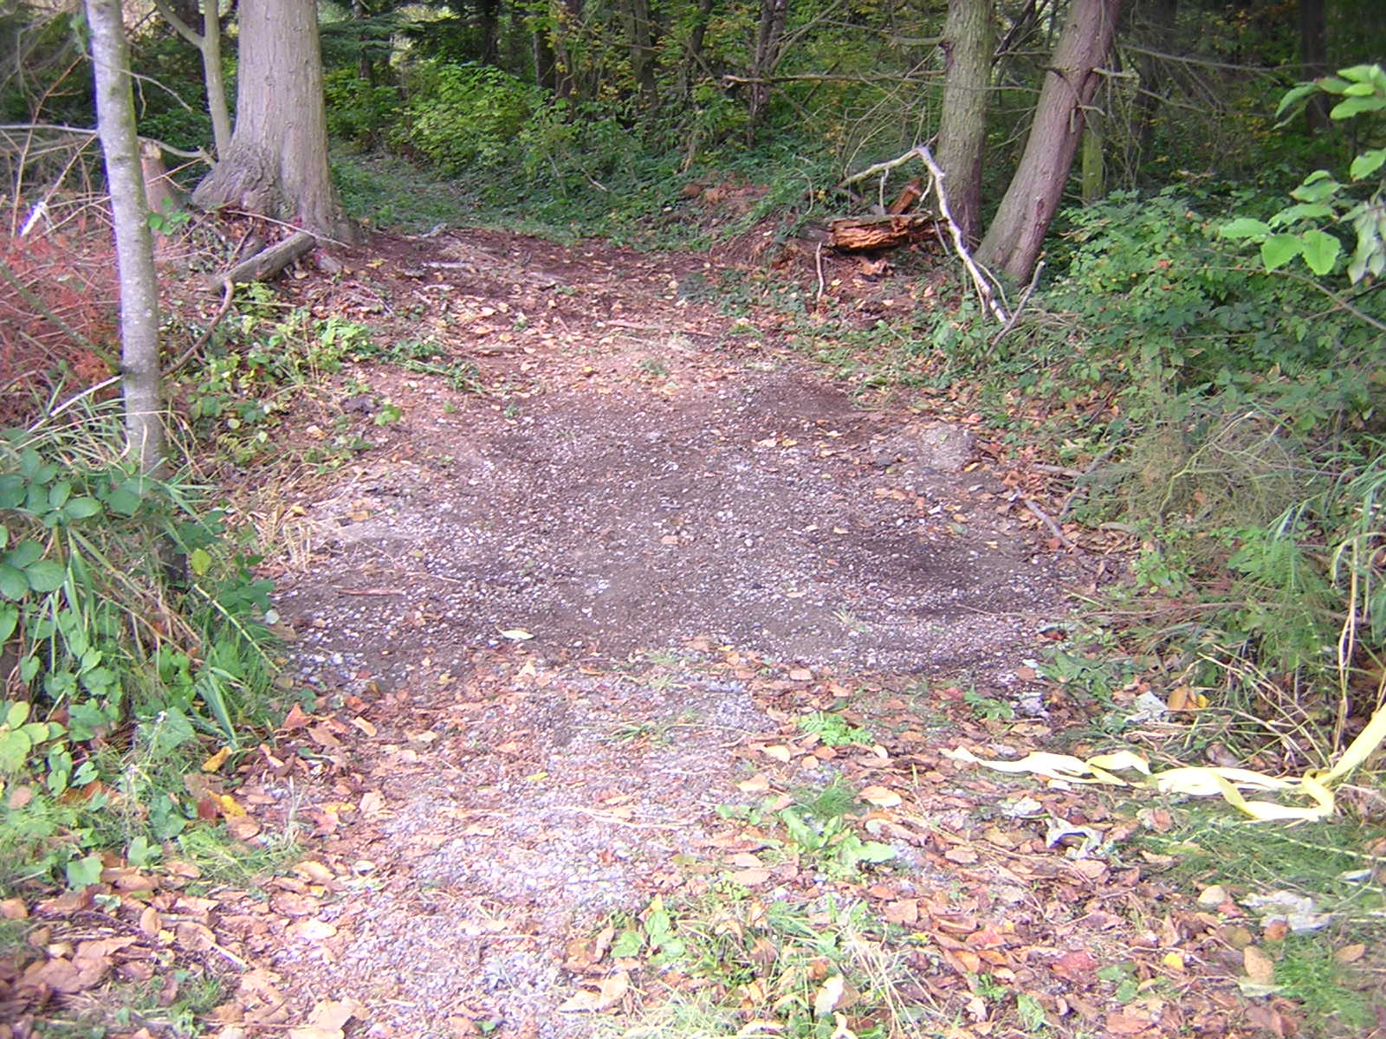
A couple of people thought this would be nicer . . .
. . . AND DECIDED TO MAKE IT HAPPEN ! ! !

Slide 15
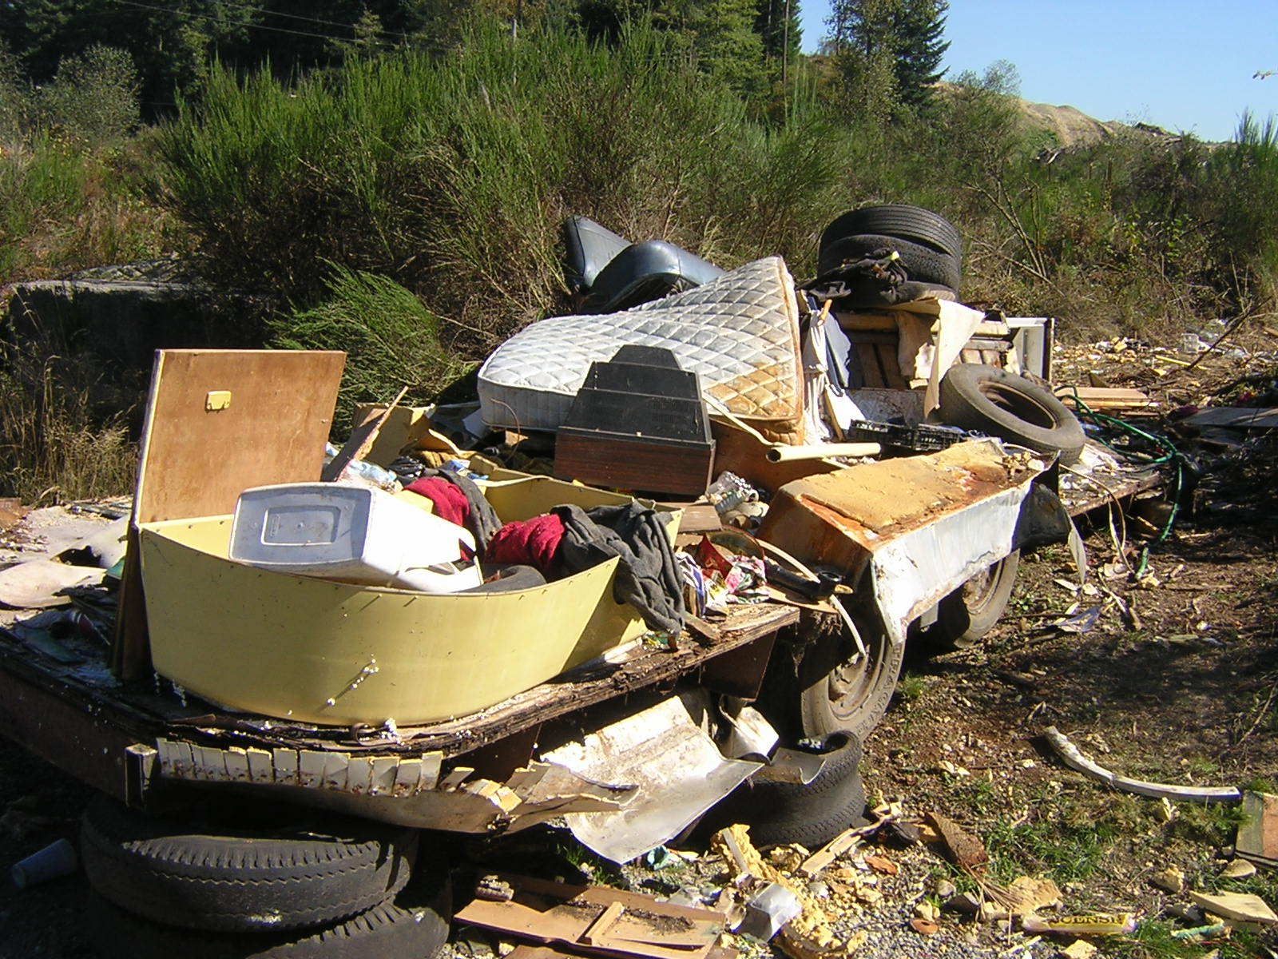
Enter friends of the trail
1996
Founded as a husband and wife duo
2002
Winner of Department of Ecology’s Environmental Excellence Award
WASHINGTON’S HIGHEST ENVIRONMENTAL HONOR

Slide 16
2002 environmental excellence award
“ . . . an asset to Snohomish County in helping to maintain public lands that are clean and available for all to enjoy”
- Matt Zybas, Snohomish County Solid Waste Management Division
“ . . . highly effective in leveraging community resources in the battle to keep Washington beautiful, and the results are impressive.”
- Polly Young, King County Department of Natural Resources
“Through their combined strengths, efforts and determination, Washington's environment is in better shape and public lands are far cleaner for all to enjoy.”
- Ray Hellwig, NW Regional Director, Department of Ecology
News release: http://www.ecy.wa.gov/news/2002news/2002-223.html

Slide 17
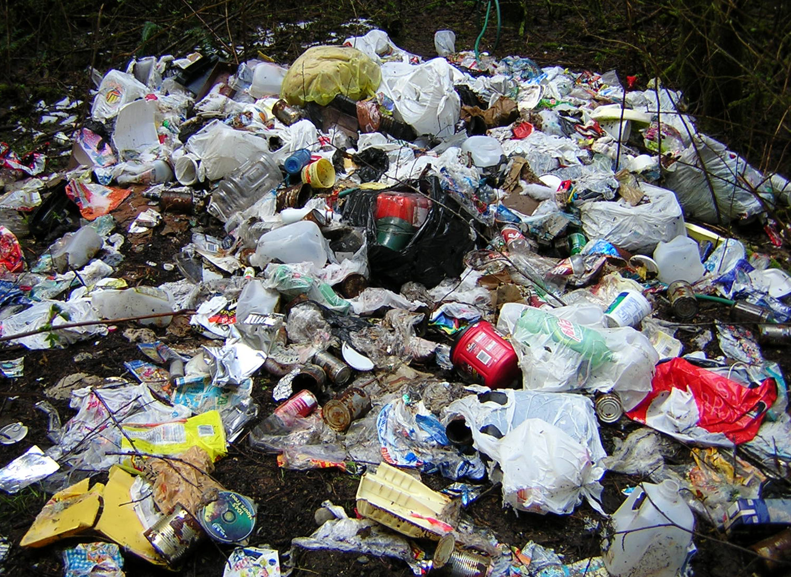
How we started
Contacting the responsible land management agencies
  Identifying the problem
    Agencies simply don’t have the resources to keep their own lands free of trash.

Slide 18
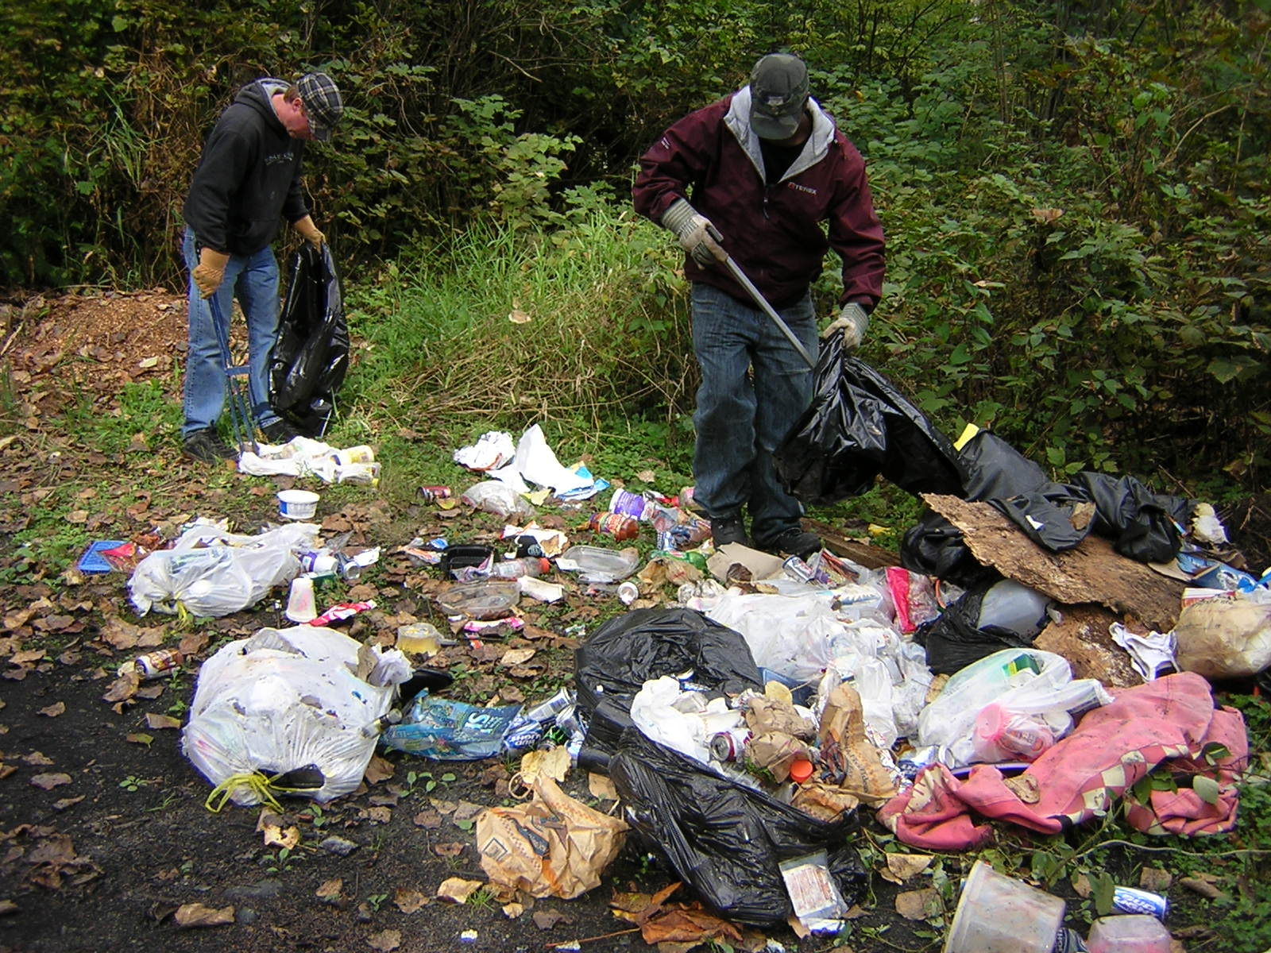
How we started
Identifying and leveraging the unused resource:
  People who owe community service requirements through the county court systems
  High school students with community service requirements for graduation

Slide 19
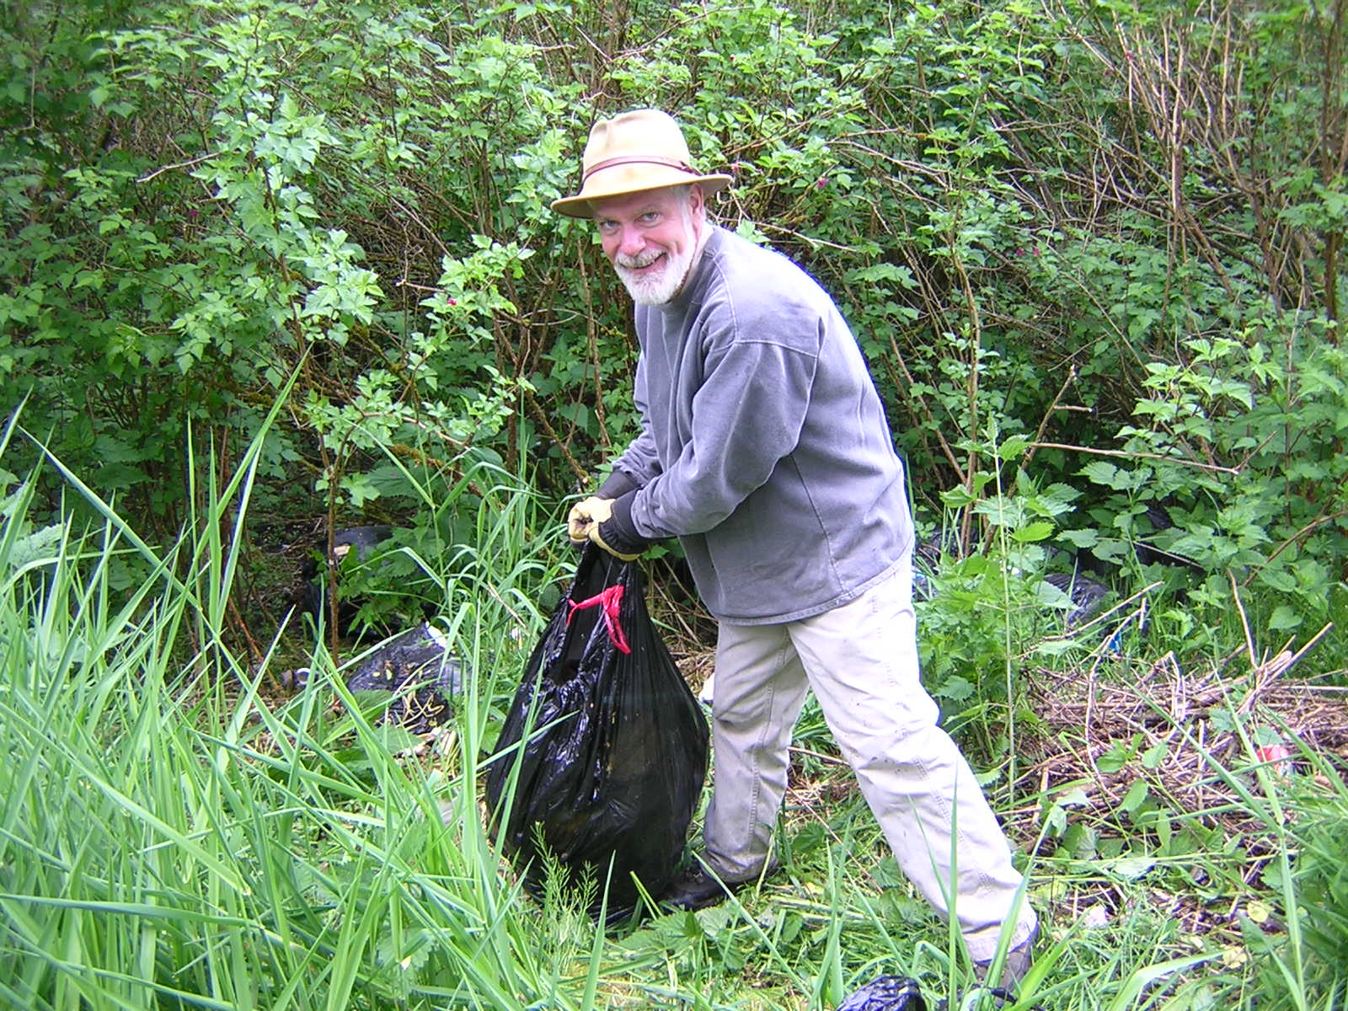
How we started
Identifying and leveraging the unused resource:
  A small corps of dedicated, reliable volunteers

Slide 20
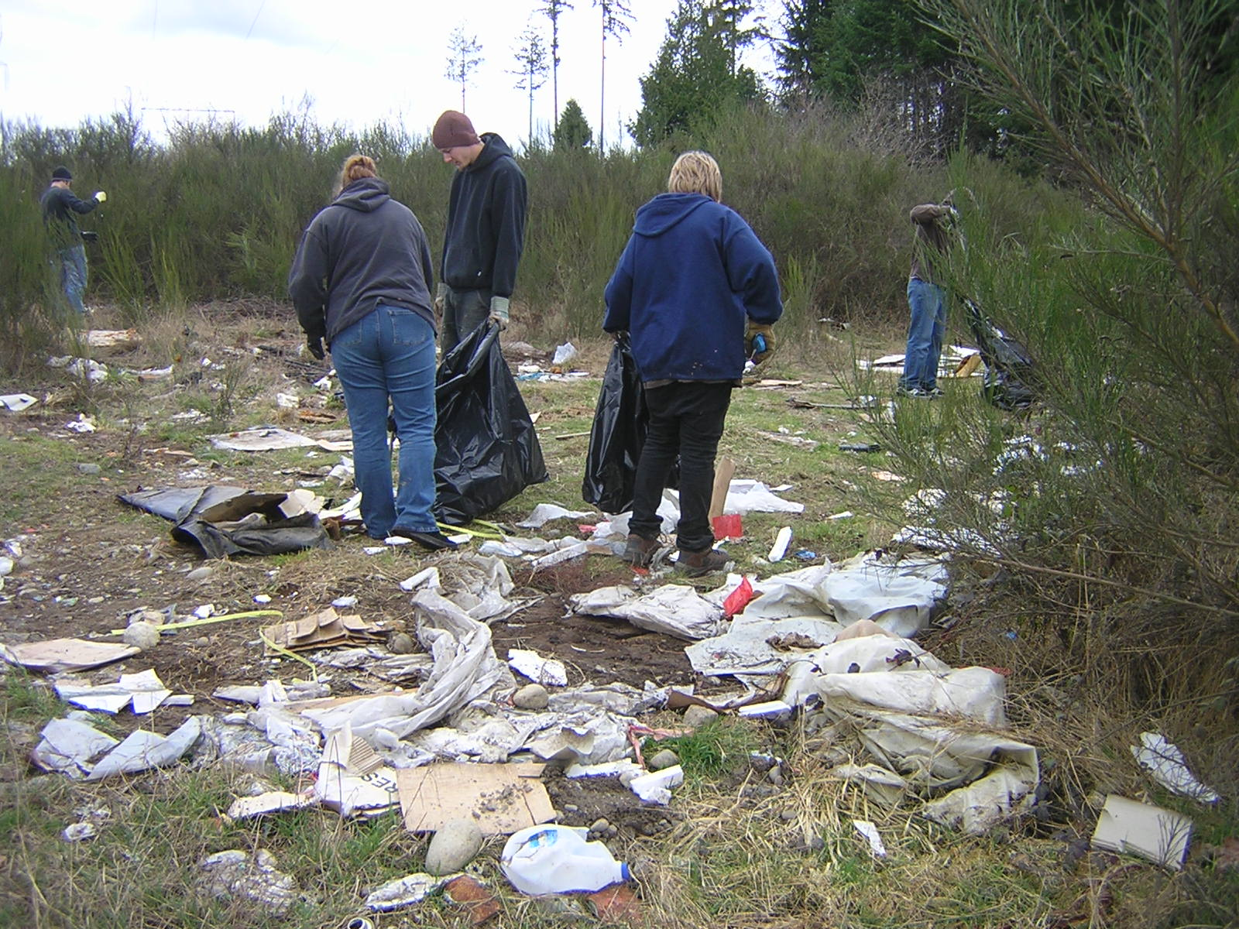
How we started
Identifying and leveraging the unused resource:
  A small corps of dedicated, reliable volunteers
    ON THE GROUND LABOR COST = $0.00 per person hour
    UNBEATABLE bang for the buck

Slide 21
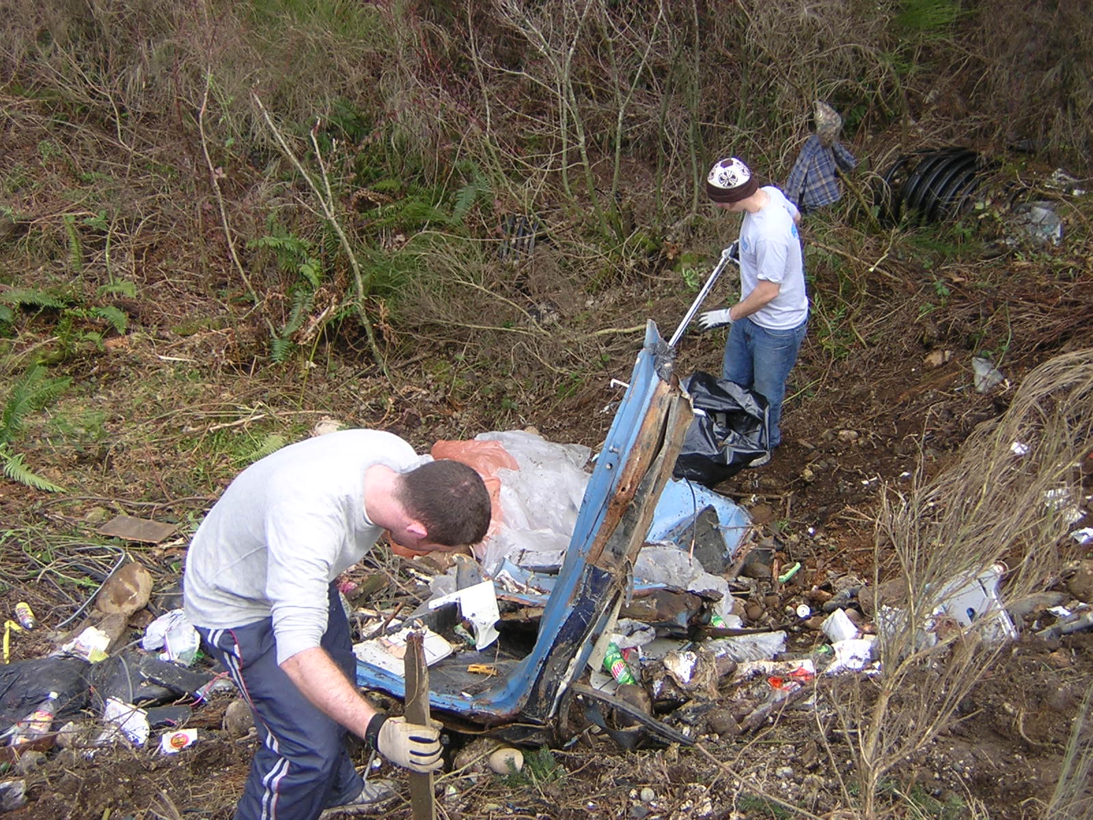
How we started
Closing in on the solution
  Establishing relations with county councilmembers
  Negotiating agreements for community service labor
  Negotiating agreements with agencies for access to and cleanup of their lands and disposal of trash
                County parks departments
                County solid waste departments
                State Department of Natural Resources
                U.S. Forest Service

Slide 22
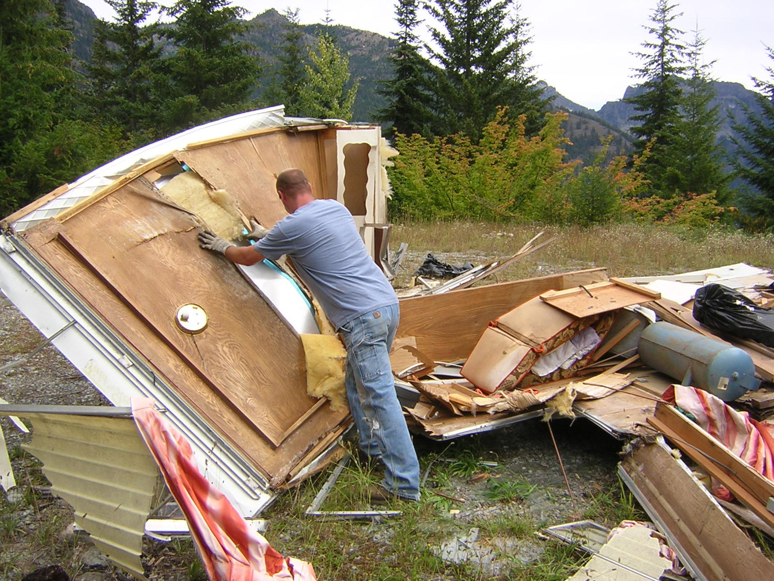
What we do
Work parties every weekend, many weekdays
  Crews go out, rain or shine
    Workers use tools, equipment and sweat and hard work to turn this . . .

Slide 23
What we do
. . . back into this.

Slide 24
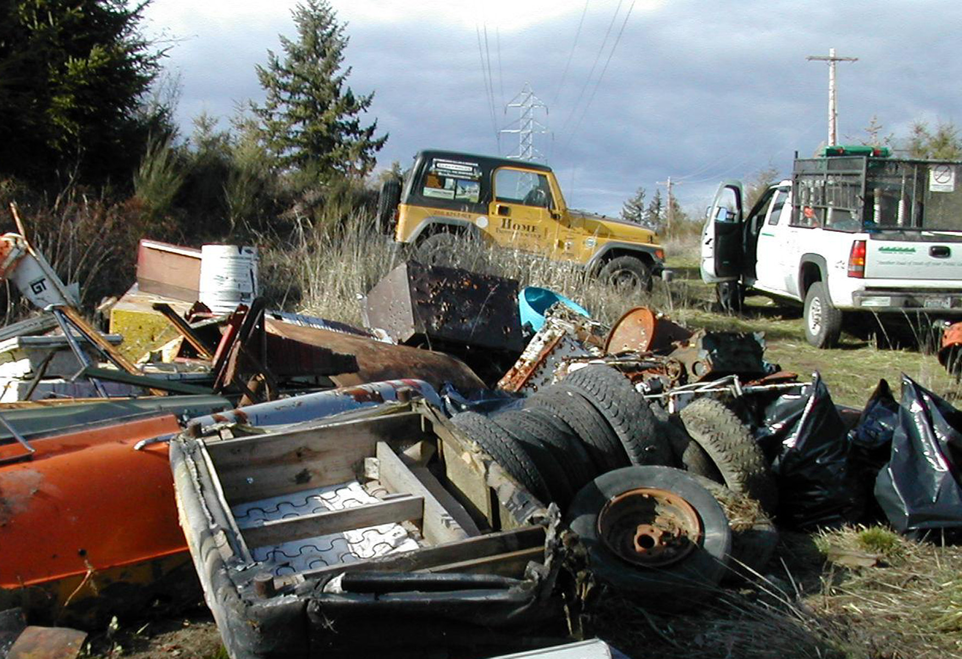
What we do
Work parties every weekend, many weekdays
  Crews go out, rain or shine
    Trash is loaded into company trucks and hauled to disposal, dropoff or recycling facilities.
  Sites are cleaned up all over the state, from Eastern Washington to the Pacific Coast in Olympic National Park.
Special arrangements with entities such as U.S. Army Reserves for hauling out large, unwieldy items

Slide 25
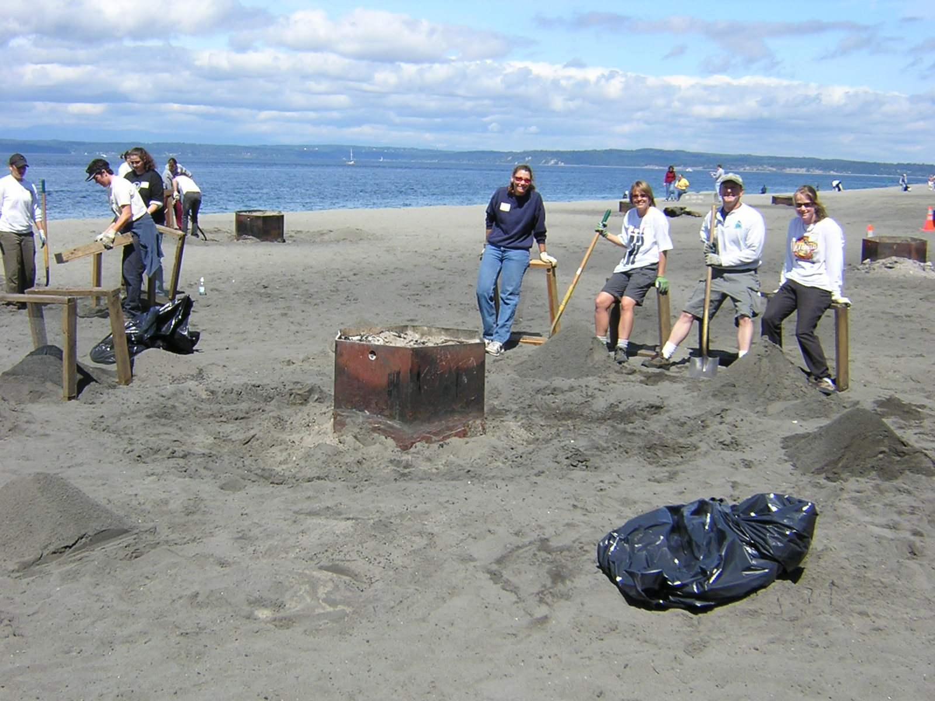
WHOM WE SERVE
Citizens in the local areas
  Improved quality of life
  Reduction in outdoor crime
    Mass underage drinking parties
    “Chop shops”
    Illegal dumping
People who come to visit
  Hikers, bikers, river rafters, picnickers, campers, fishermen, photographers, artists, etc.
  More tourists come and spend more money in clean, attractive areas.

Slide 26
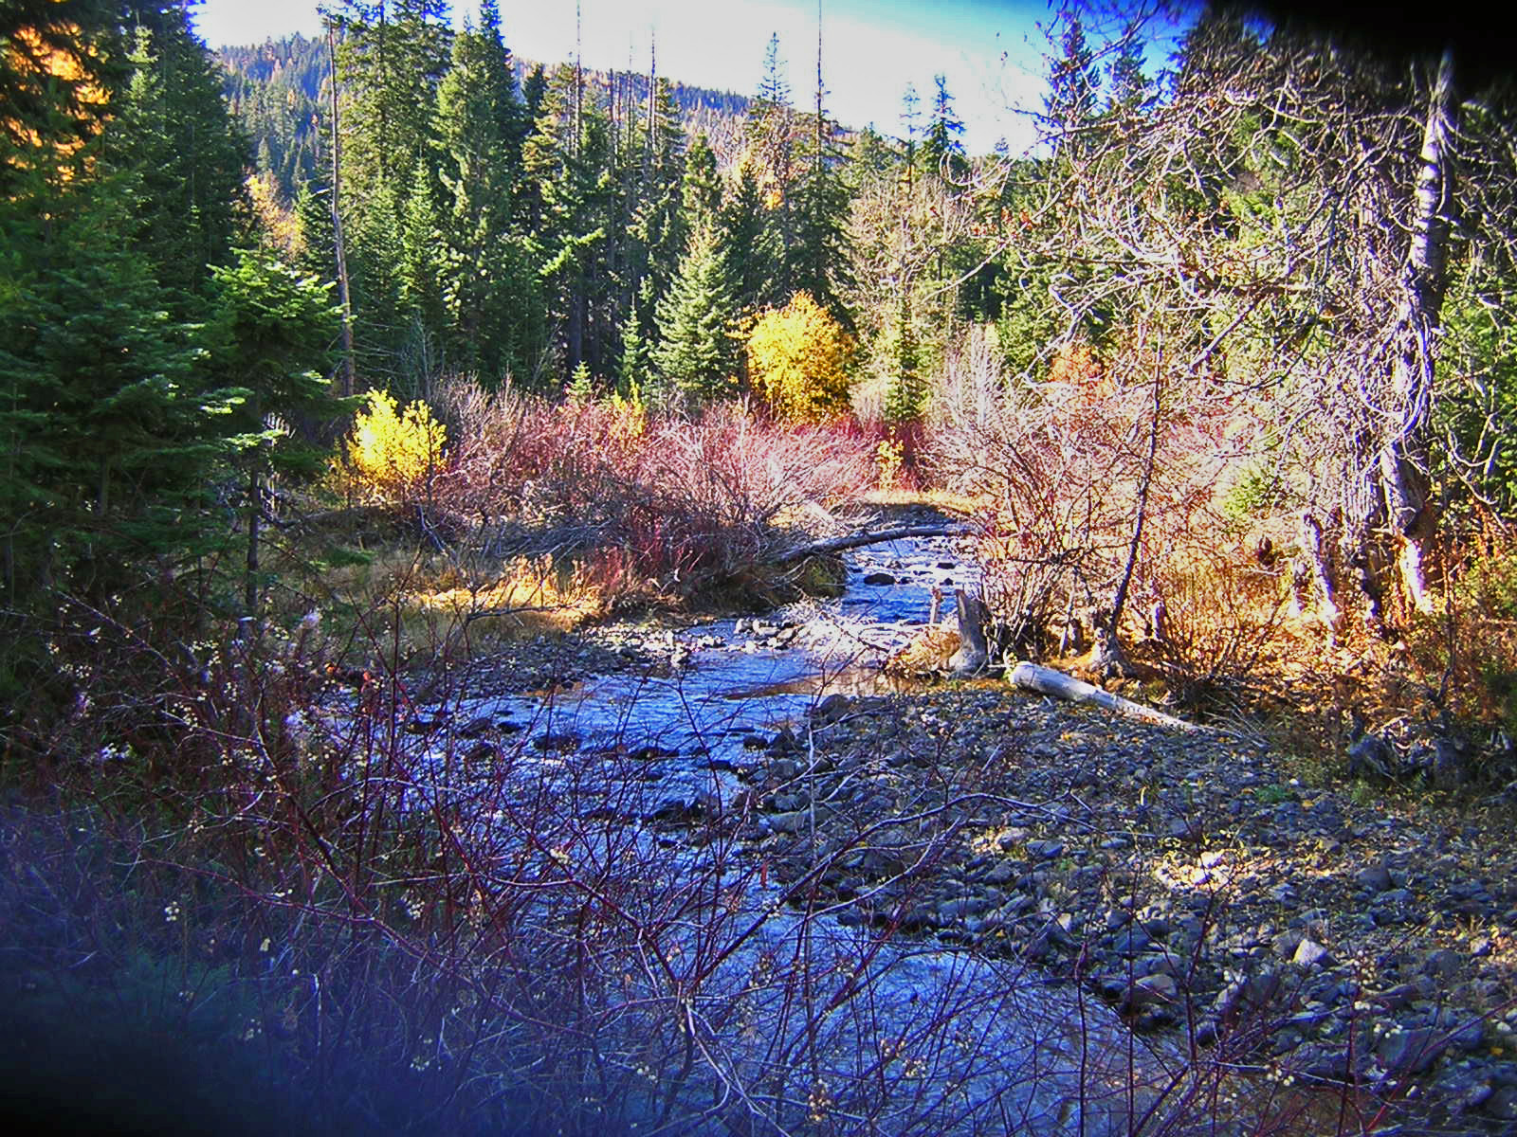
Why is it important?
Aesthetics
Wildlife
Water quality

Slide 27
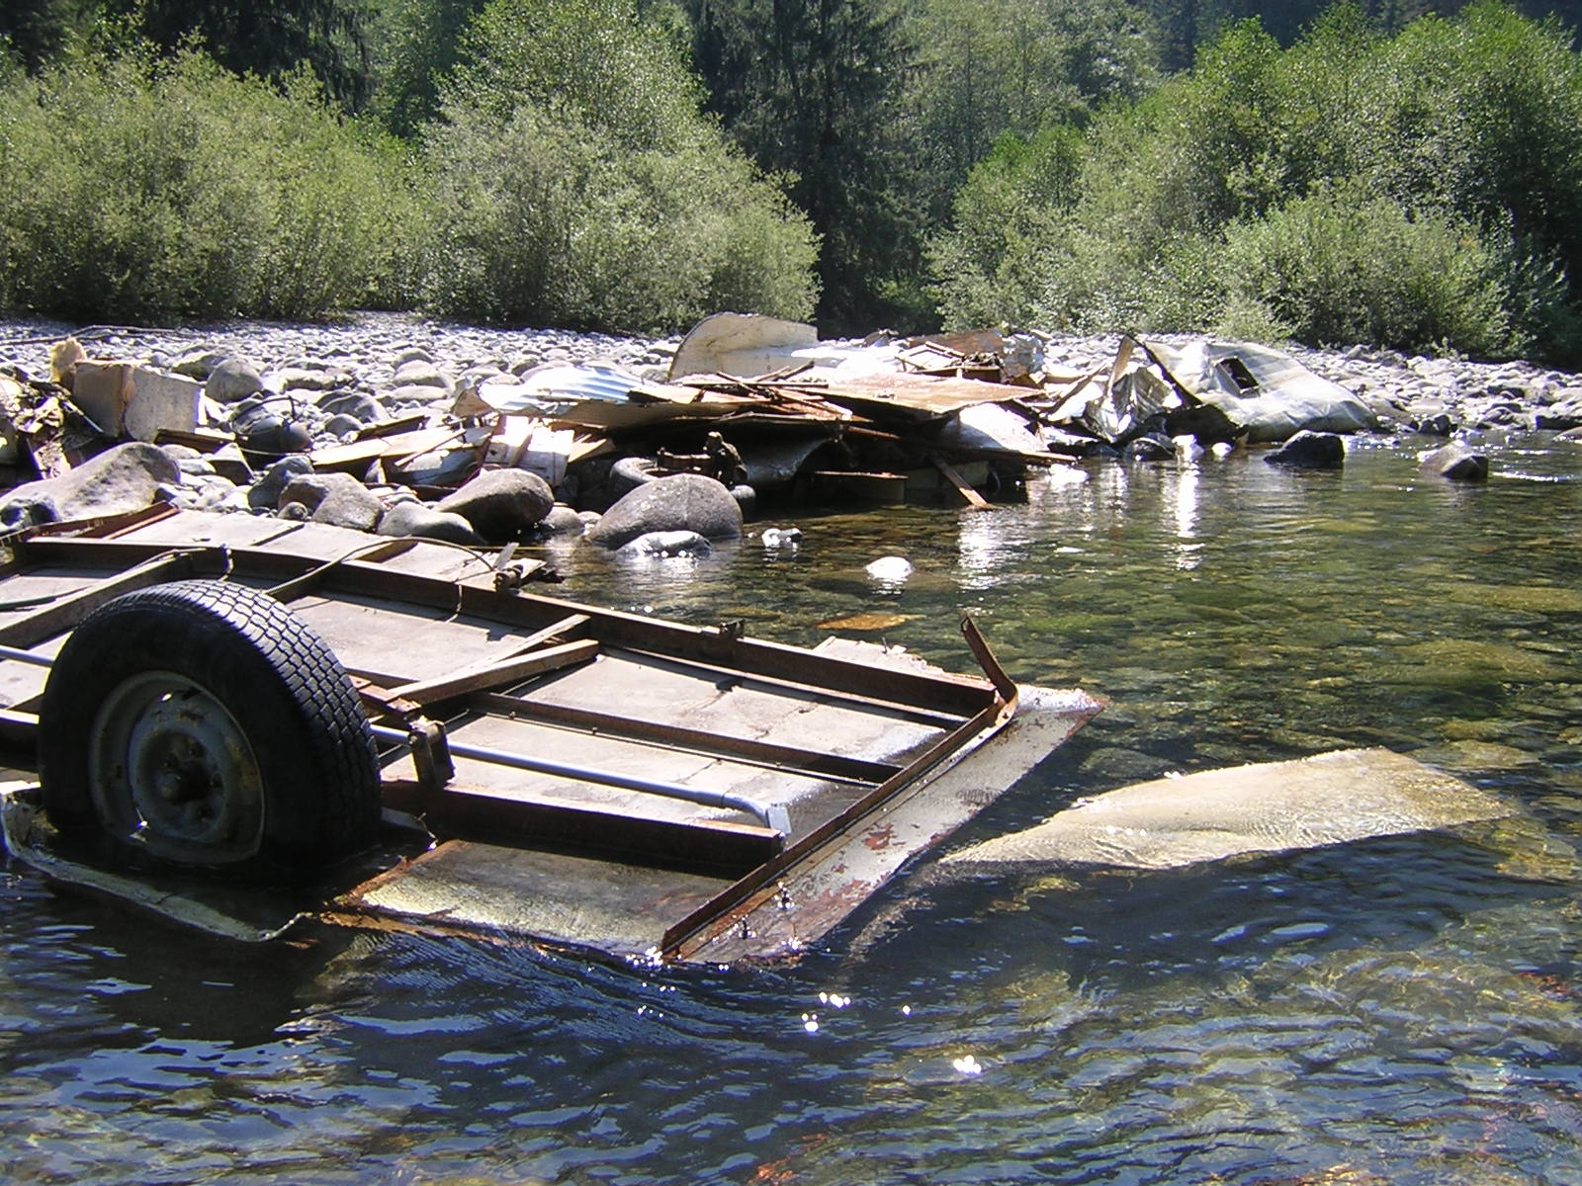
Why is it important?
Aesthetics
Wildlife
Water quality

Slide 28
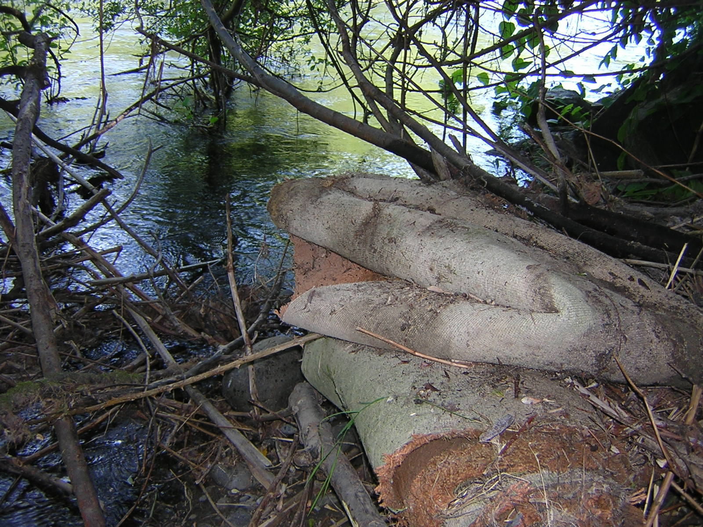
Why is it important?
Aesthetics
Wildlife
Water quality

Slide 29
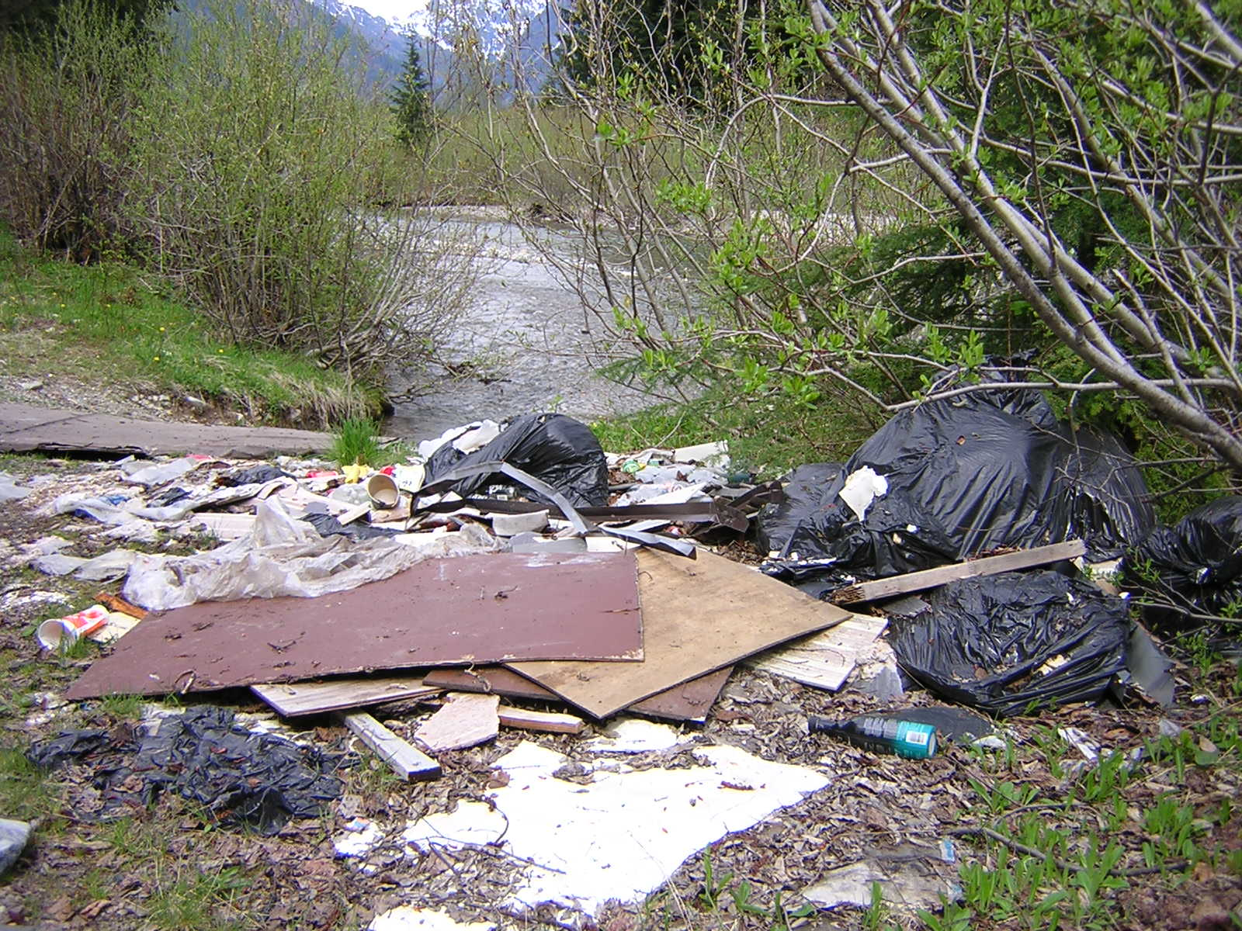
Why is it important?
Aesthetics
Wildlife
Water quality

Slide 30
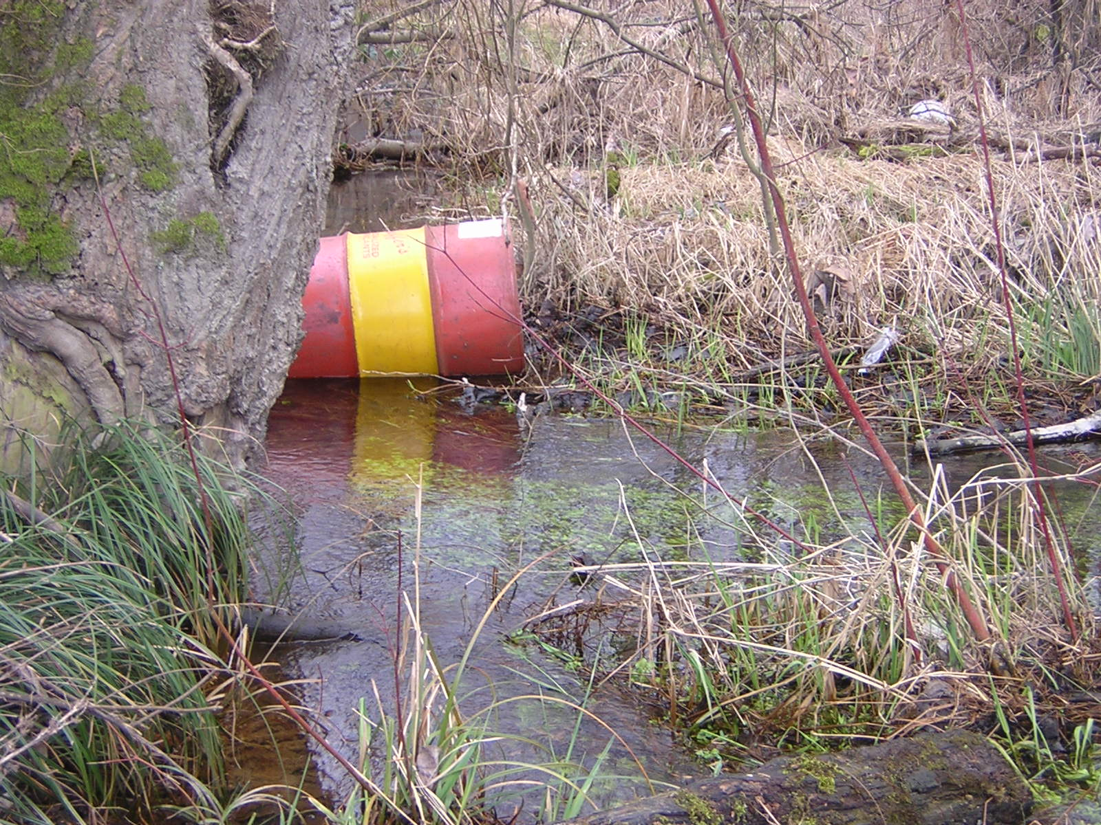
Why is it important?
Aesthetics
Wildlife
Water quality
Notes:
Show pauses here for speaker; click mouse to continue.

Slide 31
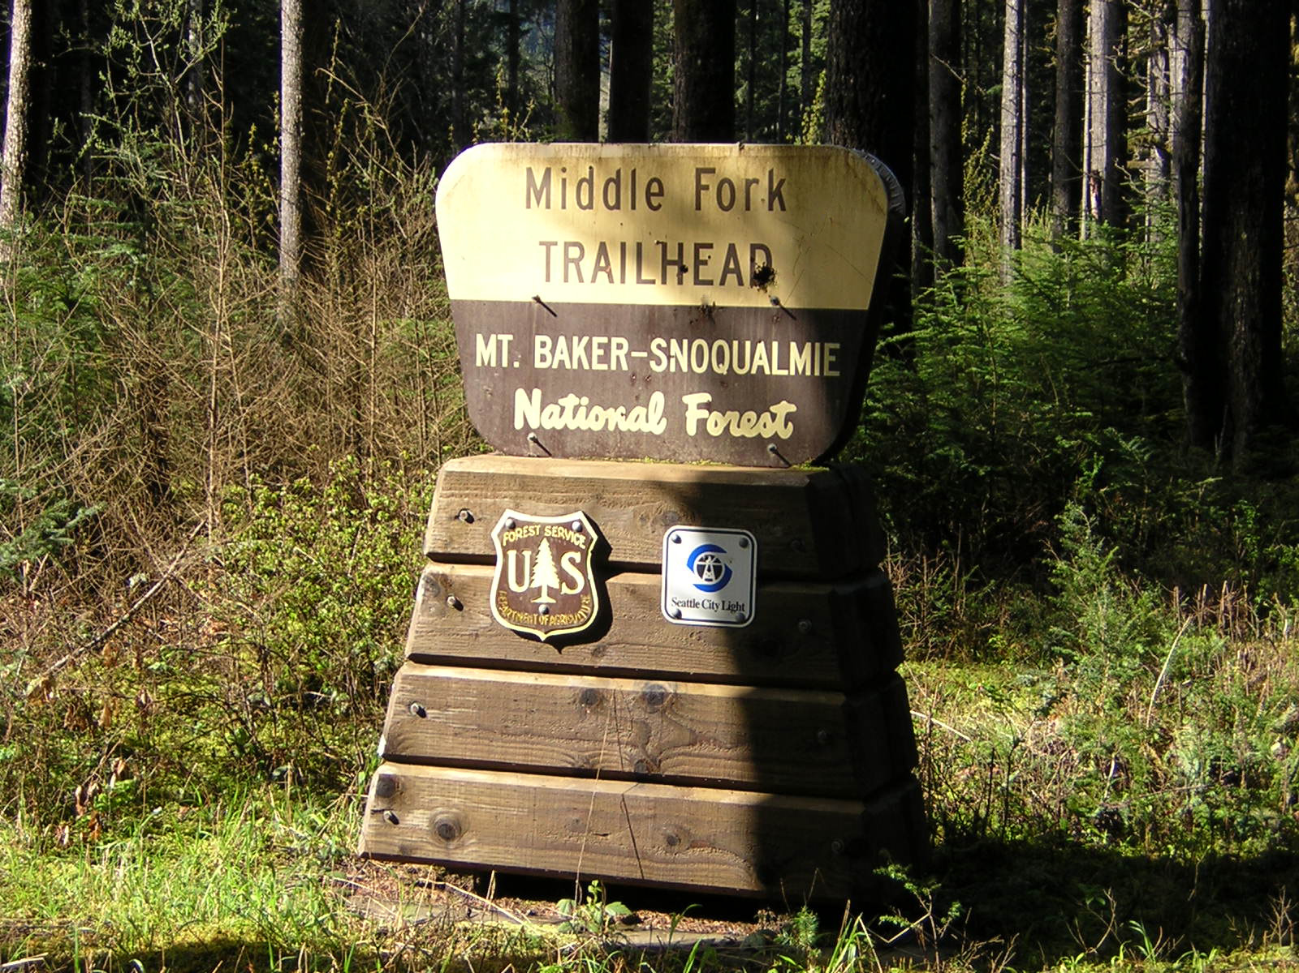
Banner accomplishments
Middle Fork Snoqualmie Valley
  Removal of car hulks, abandoned “chop shops” and countless tons of miscellaneous trash to facilitate return of peaceful recreation and restoration of wildlife habitat

Slide 32
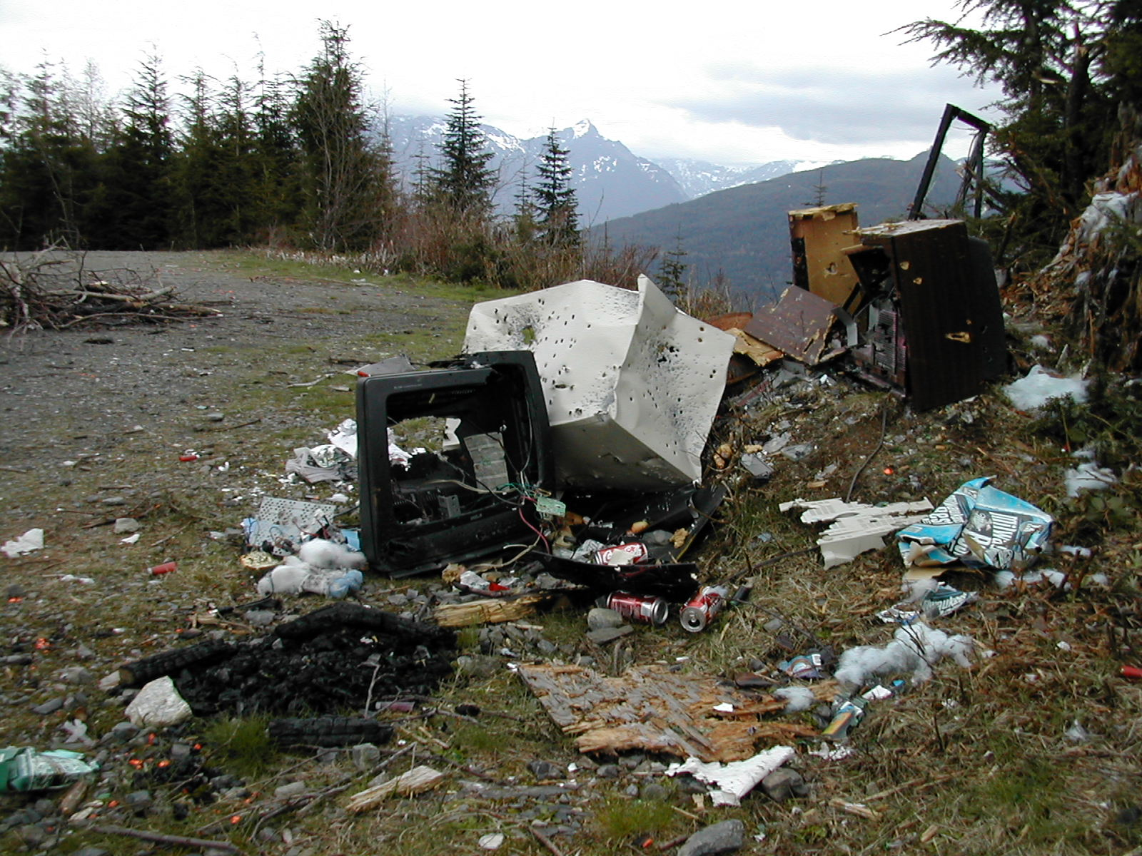
Banner accomplishments
Middle Fork Snoqualmie Valley
  Removal of car hulks, abandoned “chop shops” and countless tons of miscellaneous trash to facilitate return of peaceful recreation and restoration of wildlife habitat
Sultan Basin
  Establishment of no shooting zone by Snohomish County at Friends of the Trail’s urging
  Reduction in need for repeated cleanup of the same shooting pits

Slide 33
What we need to continue our work
All our on-the-ground labor is volunteered, so we don’t need any money to operate, right?
WRONG!!!

Slide 34
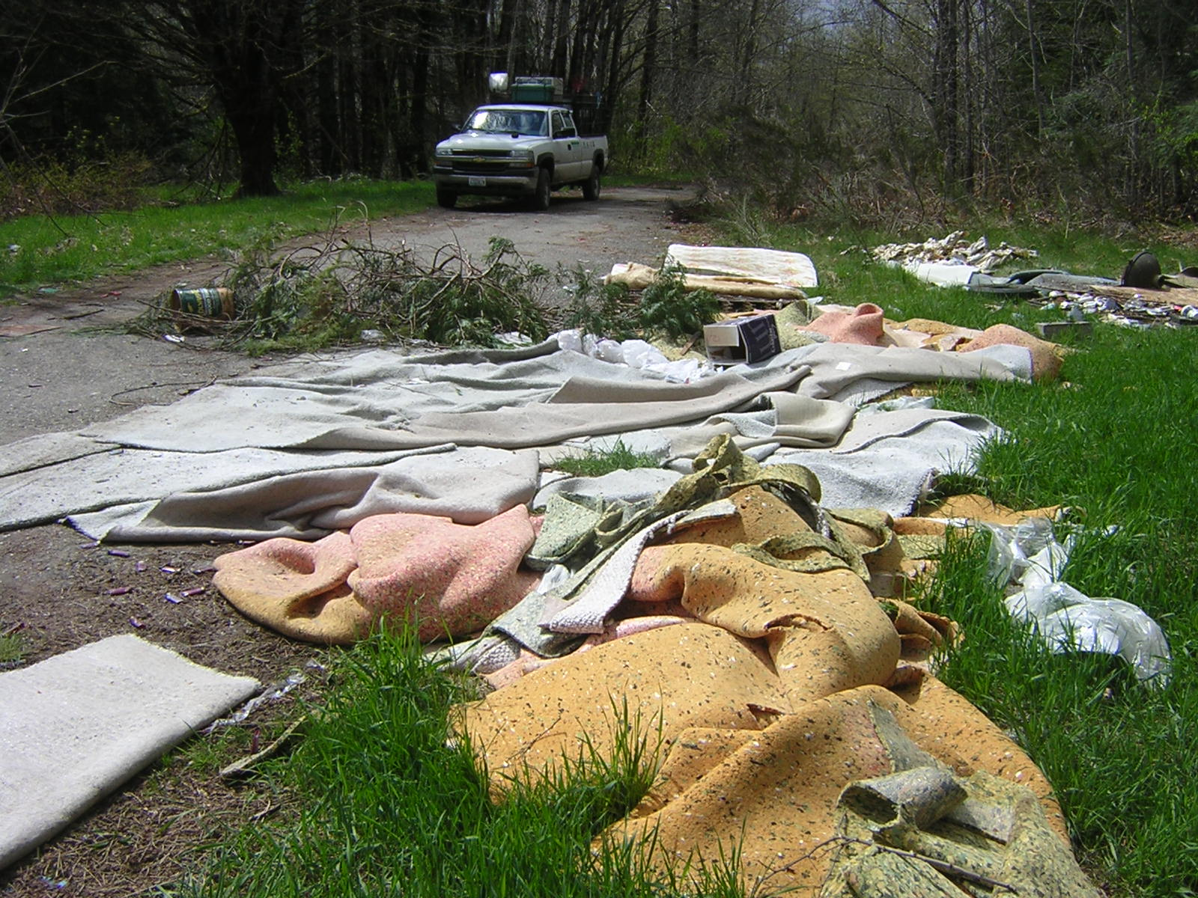
WHAT ARE OUR EXPENSES?
Company trucks
  Maintenance and repair
  Insurance
  Depreciation
Fuel
Supplies, tools and equipment

Slide 35
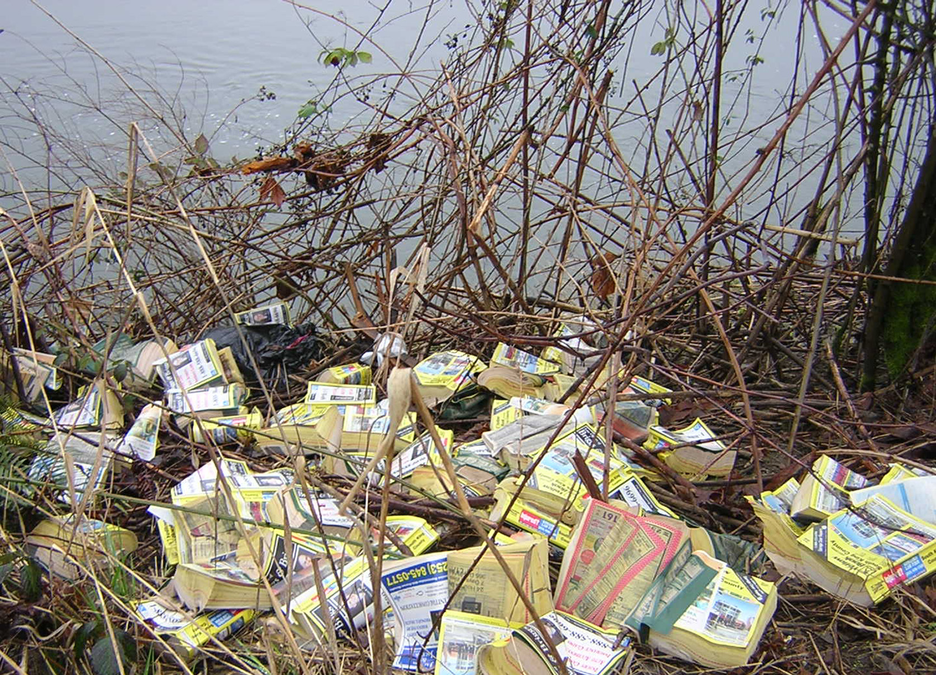
WHAT ARE OUR EXPENSES?
Portable office
  Supplies
  Telephone and Internet
  Postage, publications and printing
  Utilities
  Depreciation

Slide 36
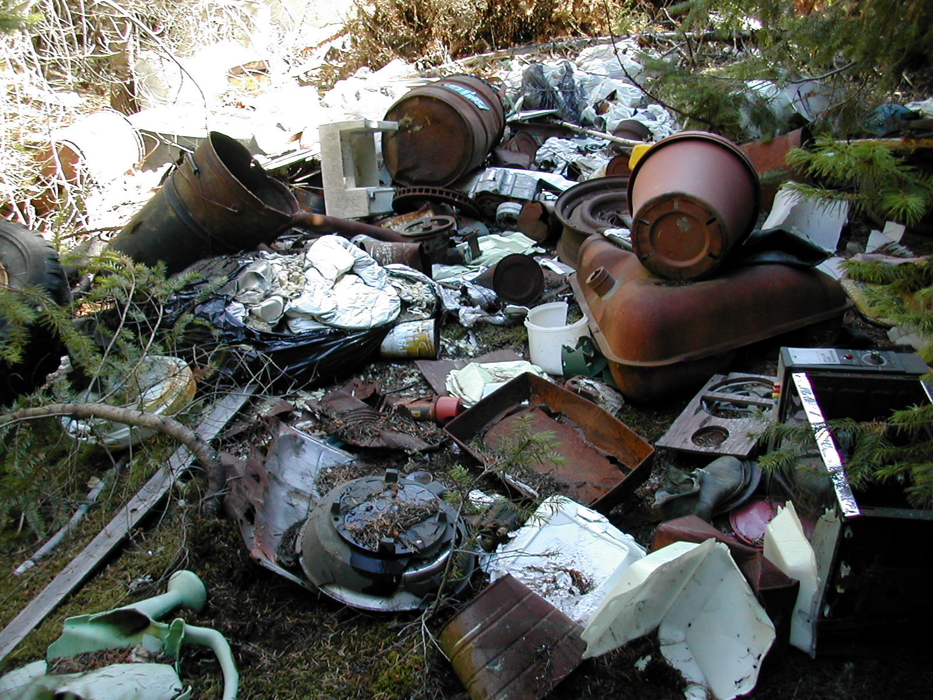
WHAT ARE OUR EXPENSES?
Disposal fees
Liability and other insurance
IRS registration and miscellaneous
Skeleton paid staff
  Executive Director/crew leader (full time)
  Secretary/treasurer/grantwriter (part time)
  Assistant crew leader (part time)

Slide 37
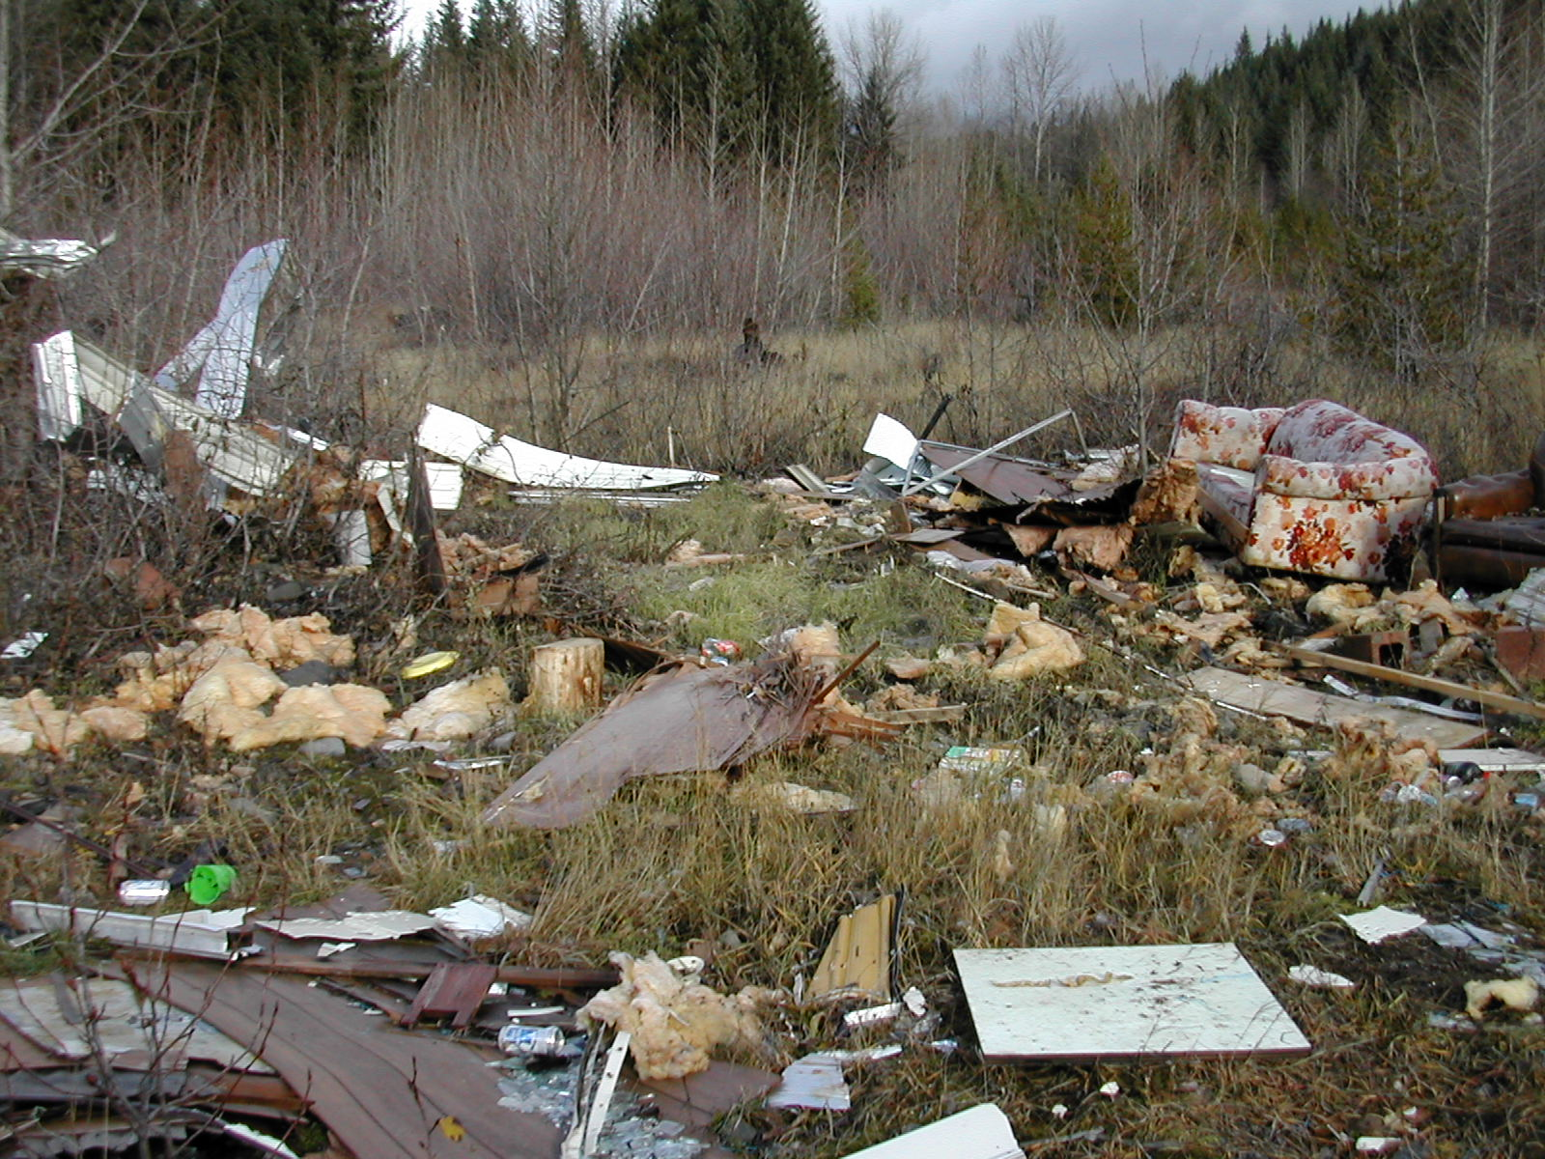
early funding
1996-99
Funded using founders’ personal funds
  Executive Director took no salary for 2-1/2 years.
  Founders paid for gas and insurance with their own money and donated phone cards.
Later Years
Government and grant funding - but always precarious
Always a shoestring budget

Slide 38
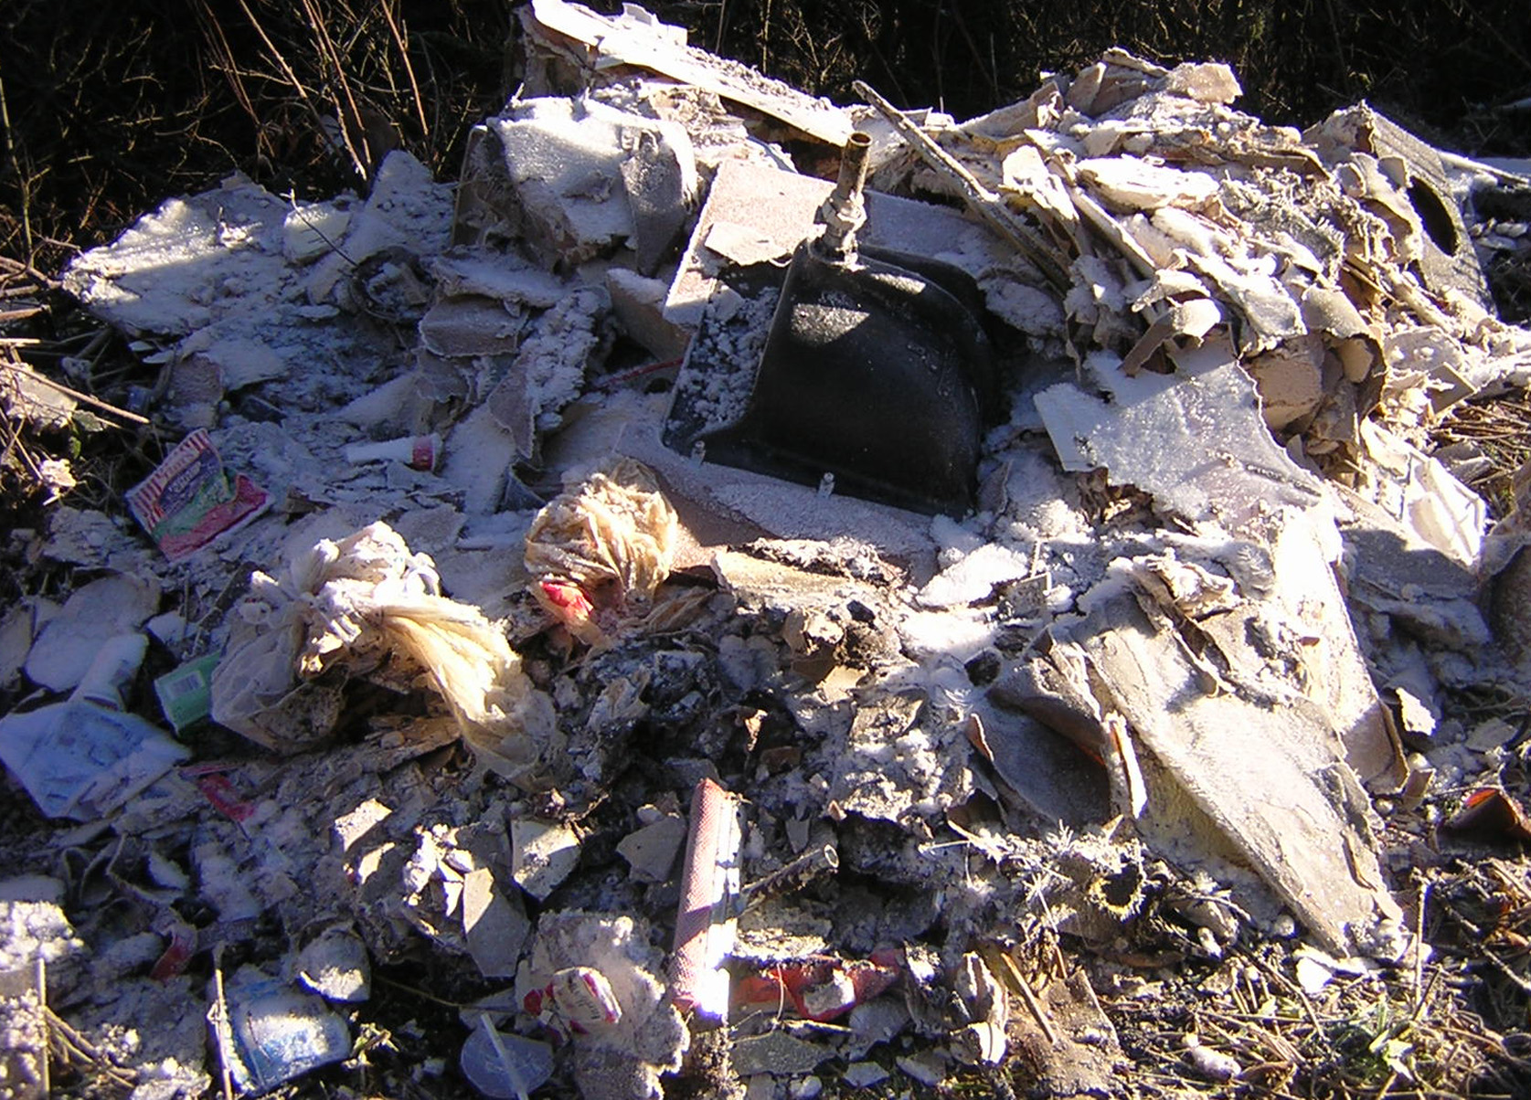
Where has OUR recent funding come from?
66% County governments, programs and grants
27% - 32% U.S. Forest Service programs
2% - 7%
Foundations
& misc.

Slide 39
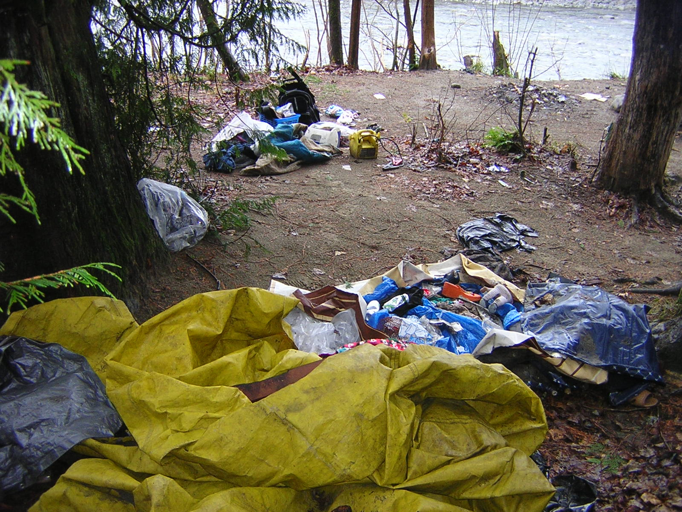
Funding issues
Grants often have restrictions as to place and duration.
  Can’t use funds from Grant X, earmarked for Location X, to clean up trash in Location Y.
  If Grant X funds for Location X haven’t been used up by end of grant period, funds must be returned & can’t be transferred to other work.
  Extremely difficult to coordinate when we’re doing different things for different agencies.
  Challenge is figuring out how to pay for everything and keep funds separated as to grant source.

Slide 40
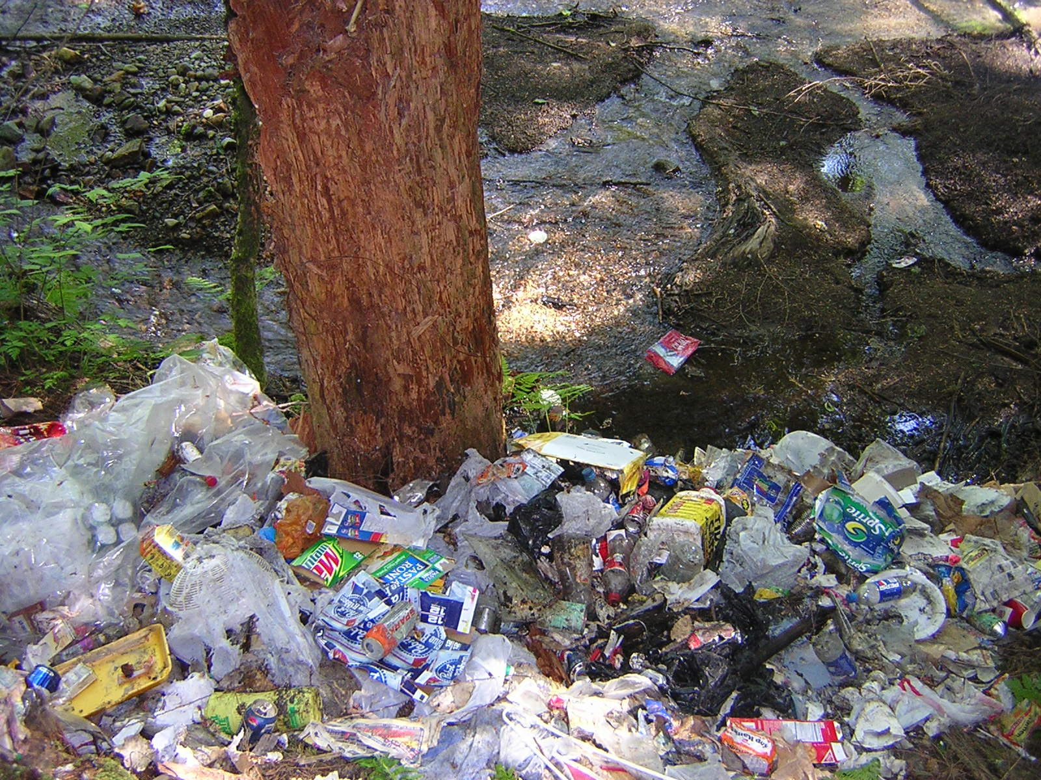
Funding issues
Mainstay government support is dwindling with squeezed agency budgets.
To operate more efficiently and be more responsive to growing needs, we need unrestricted general fund money that is not earmarked for specific areas, purposes and times of year.

Slide 41
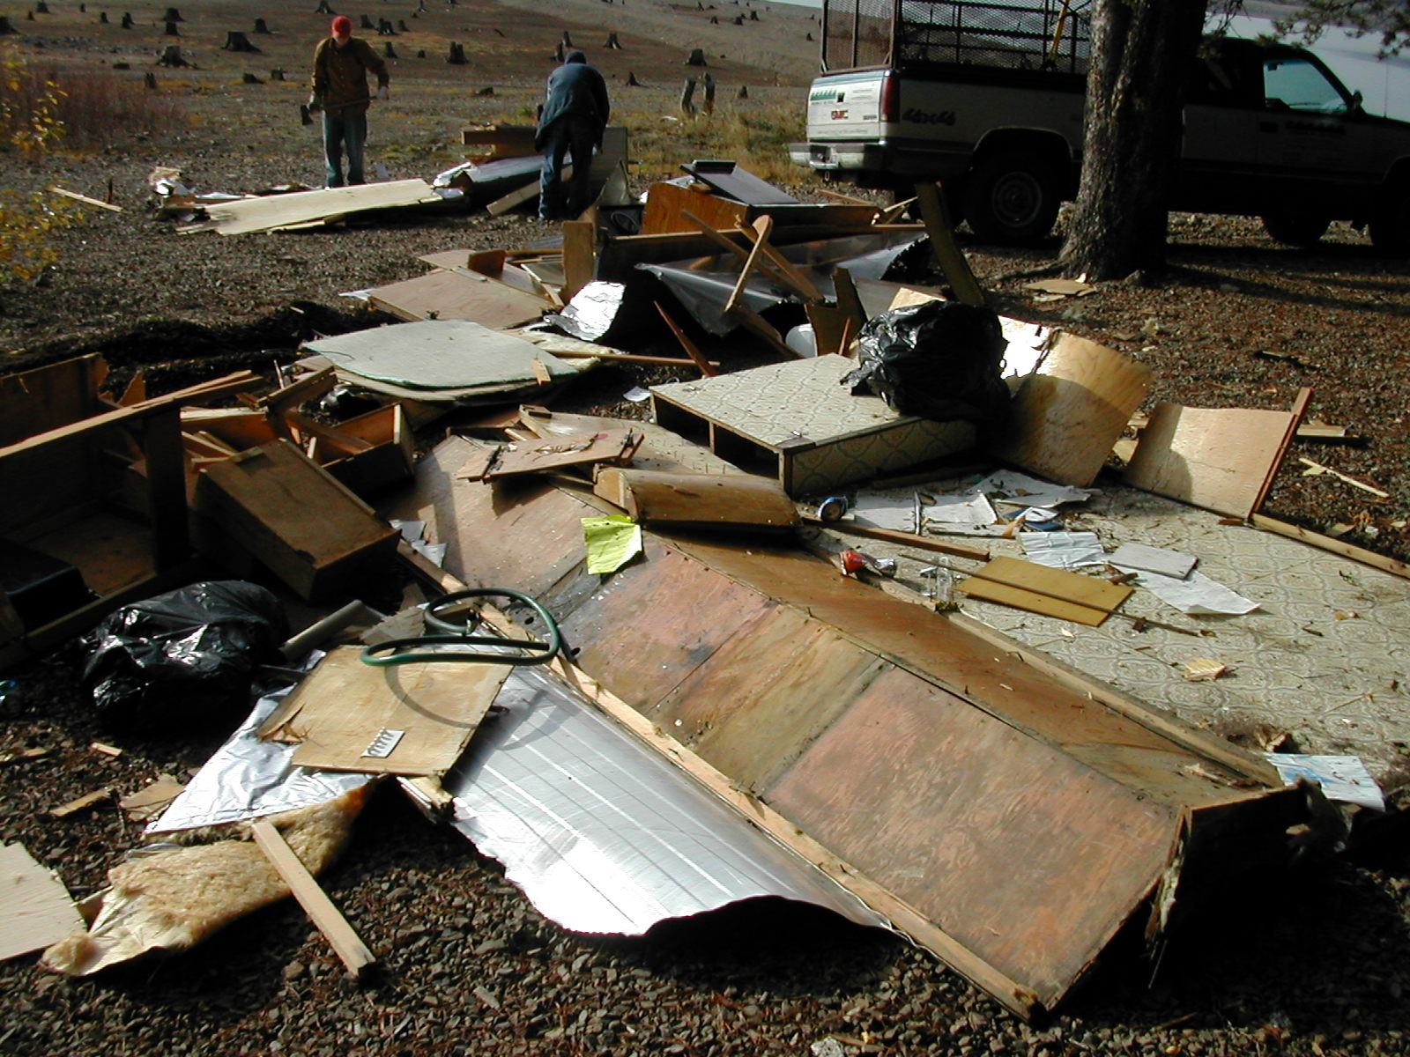
Funding issues
Funding that is sustainable from year to year to service ongoing capital needs is more useful than funding that stops after one year.
  Equipment needs to be maintained.
  Crew leader needs to be paid.
  Trucks needs to be replaced as they wear out.

Slide 42
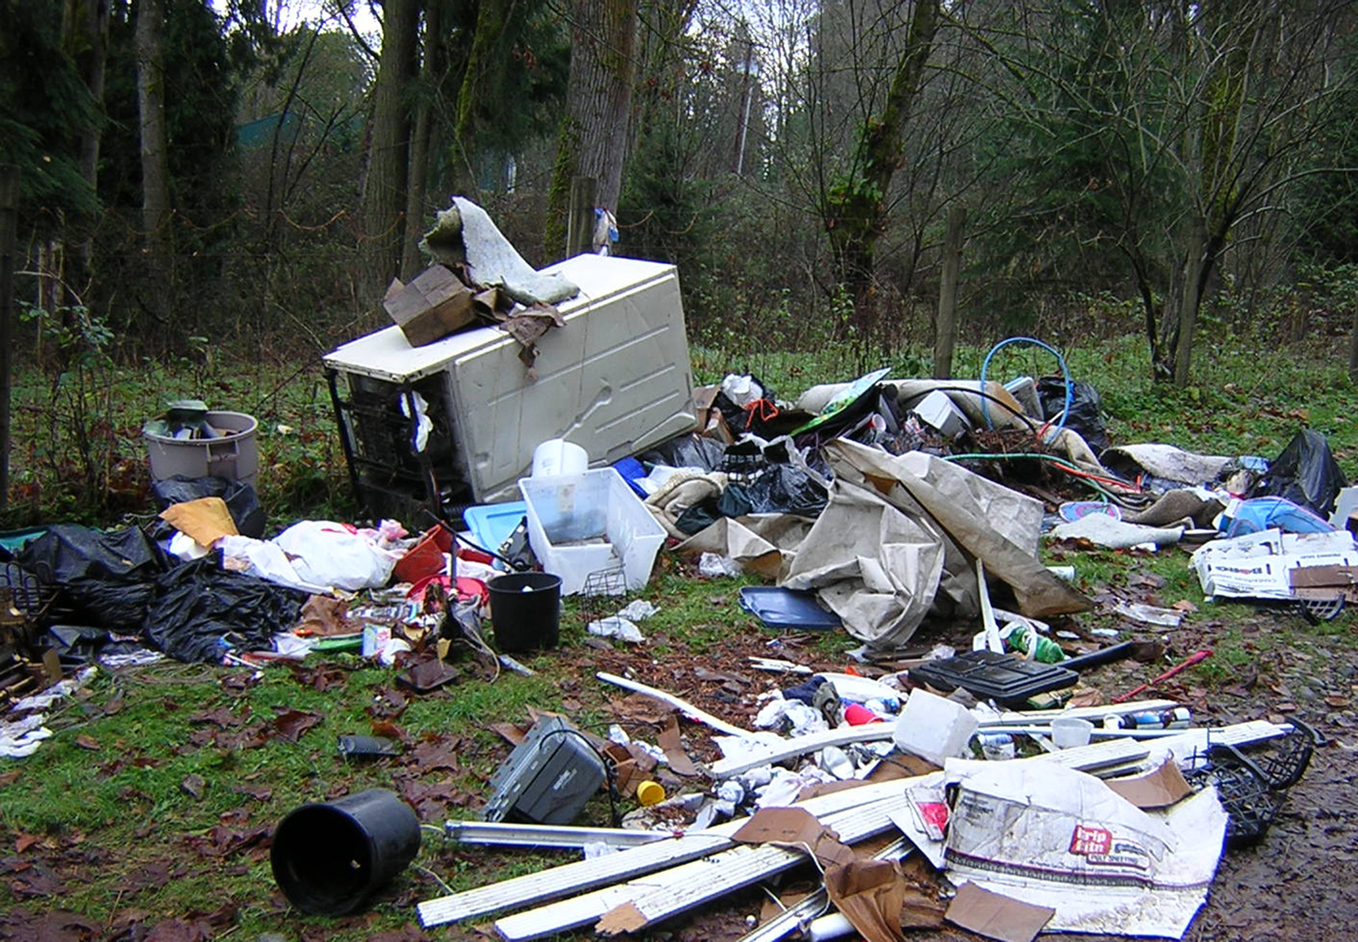
Funding issues
Grants large enough to facilitate achieving our goals are more efficient than large numbers of small donations.
              Paperwork and breakdown reporting requirements are the same for a $5,000 grant as for a $50,000 grant.
Secretary/treasurer/grantwriter already works a full time job with another employer.

Slide 43
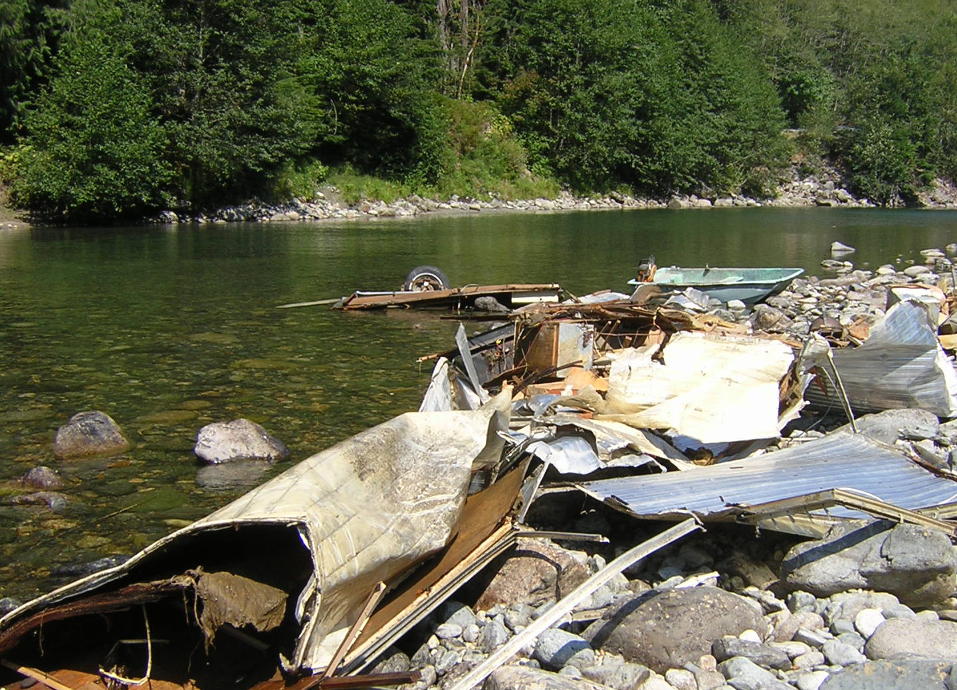
Funding issues
What we could do with your financial help
  Maintain current level of service.
  Clean up problem areas that we no longer have funds to work in.
  Maintain problem areas we have previously cleaned up, or they will get as bad as they were before.
  Expand into new areas.

Slide 44
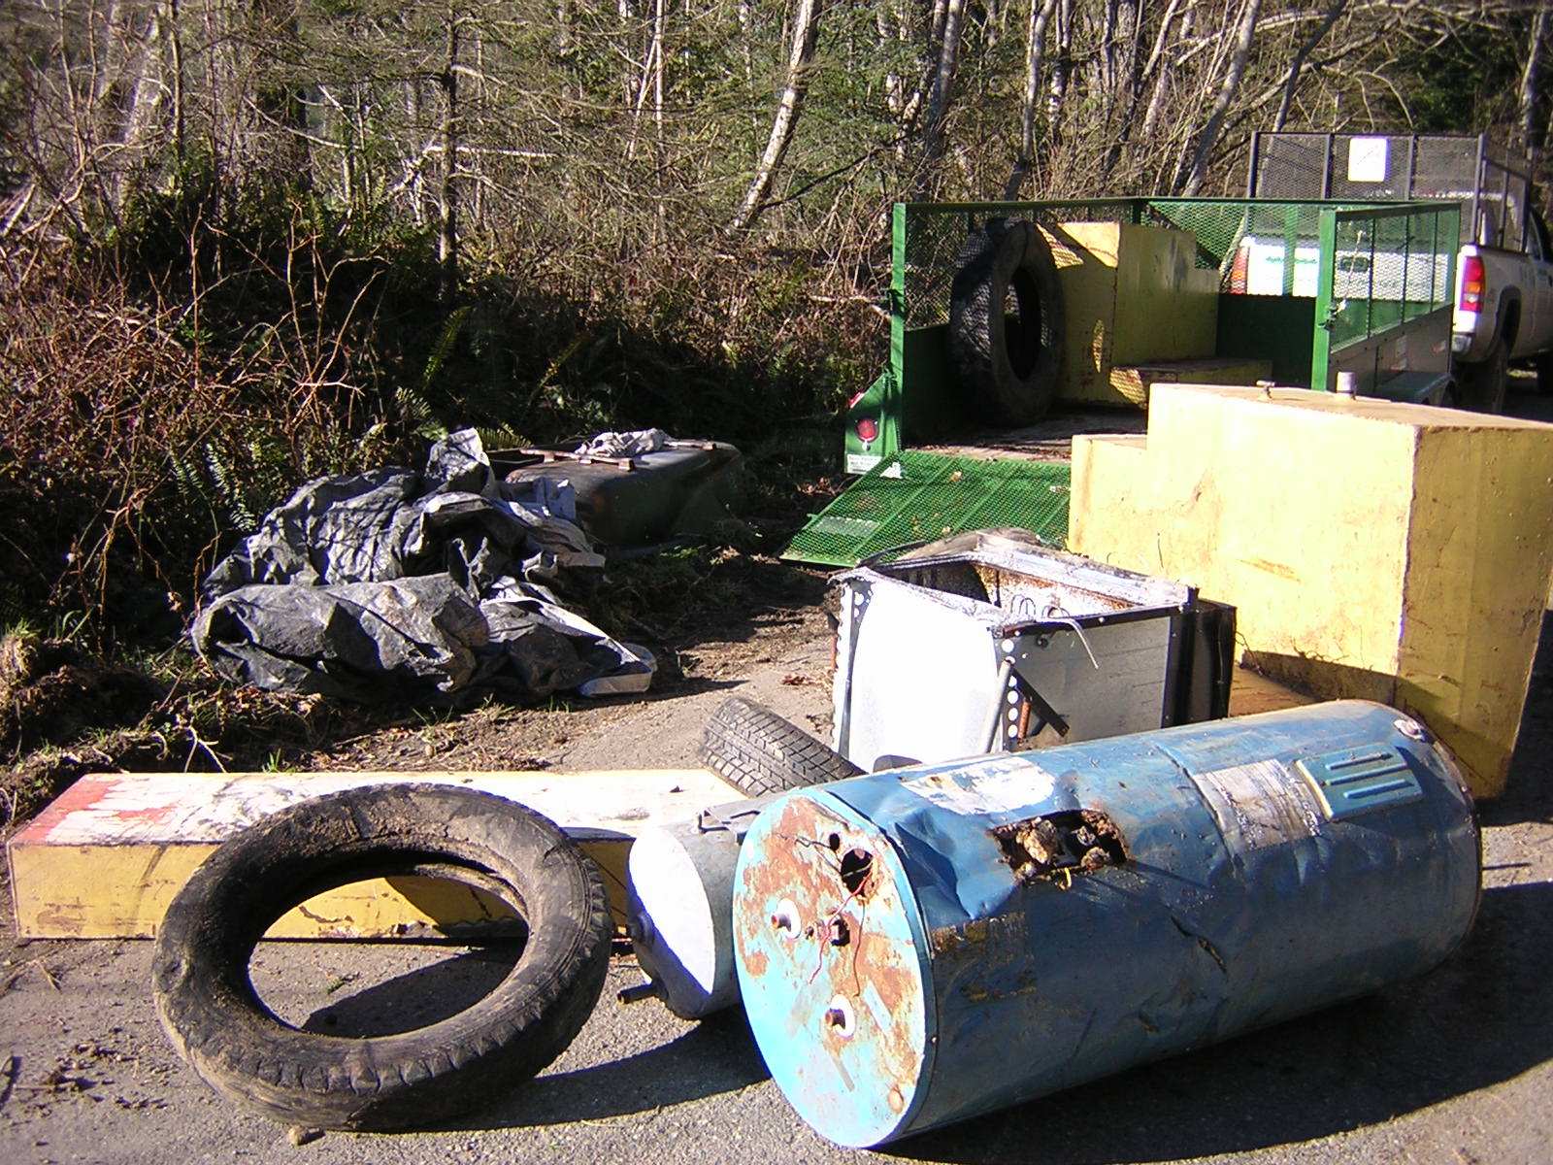
Funding issues
WISH LIST
Boat for Snoqualmie River project
Truck dealer willing to donate truck
Experienced grantwriters willing to donate services

Slide 45
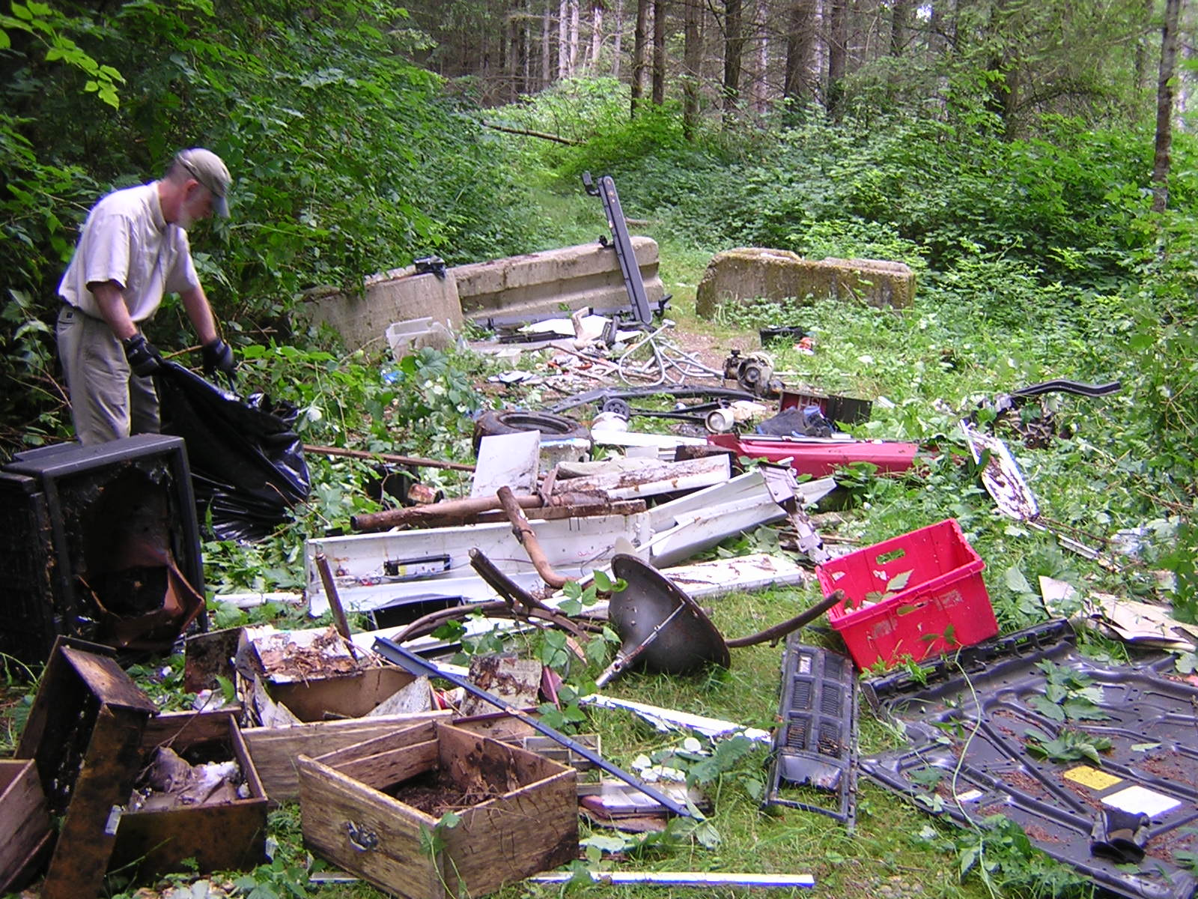
Funding issues
We respond to each and every funded request for cleanup of public lands and waterways from whomsoever
BUT . . .
We can’t guarantee a response to a request if it is not funded.
We can’t “rob Peter to pay Paul.”

Slide 46
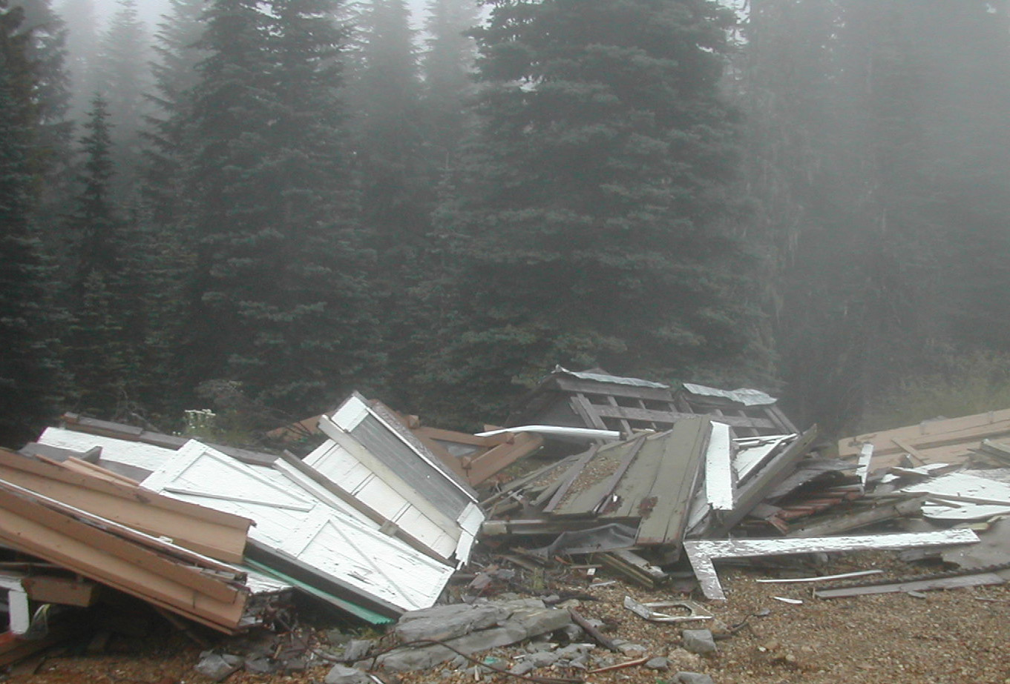
WHAT SETS US APART?
Most outdoor volunteer groups don’t work in the winter.
We do, cleaning up your public lands and waterways and providing opportunities for people with community service requirements year round.

Slide 47
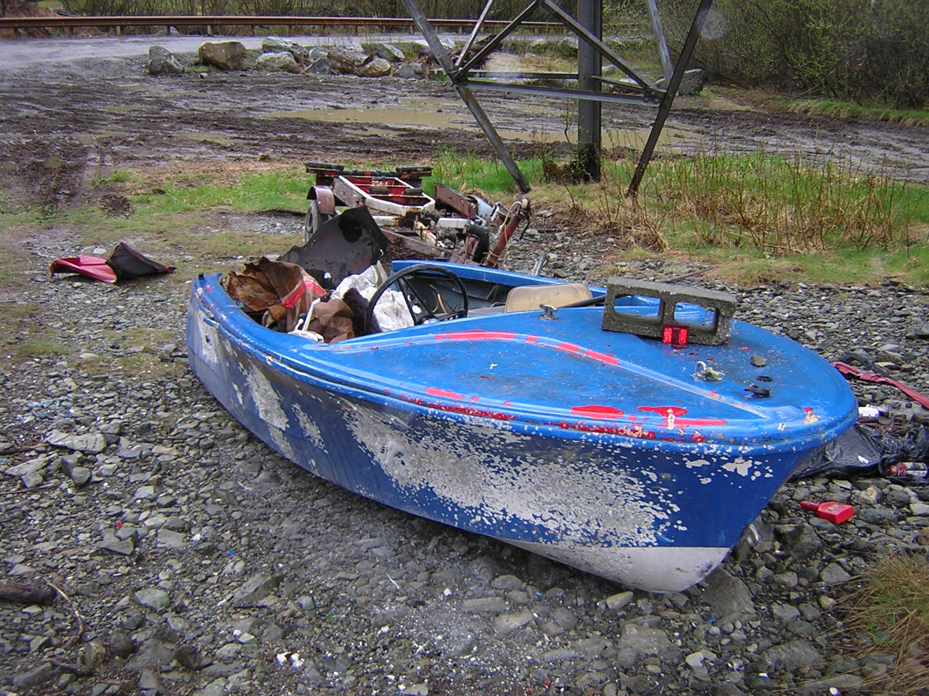
WHAT SETS US APART?
We tackle tough, remote projects that are not for the faint of heart.
  Powerline rights of way
    Magnets for trash due to almost total lack of access restrictions

Slide 48
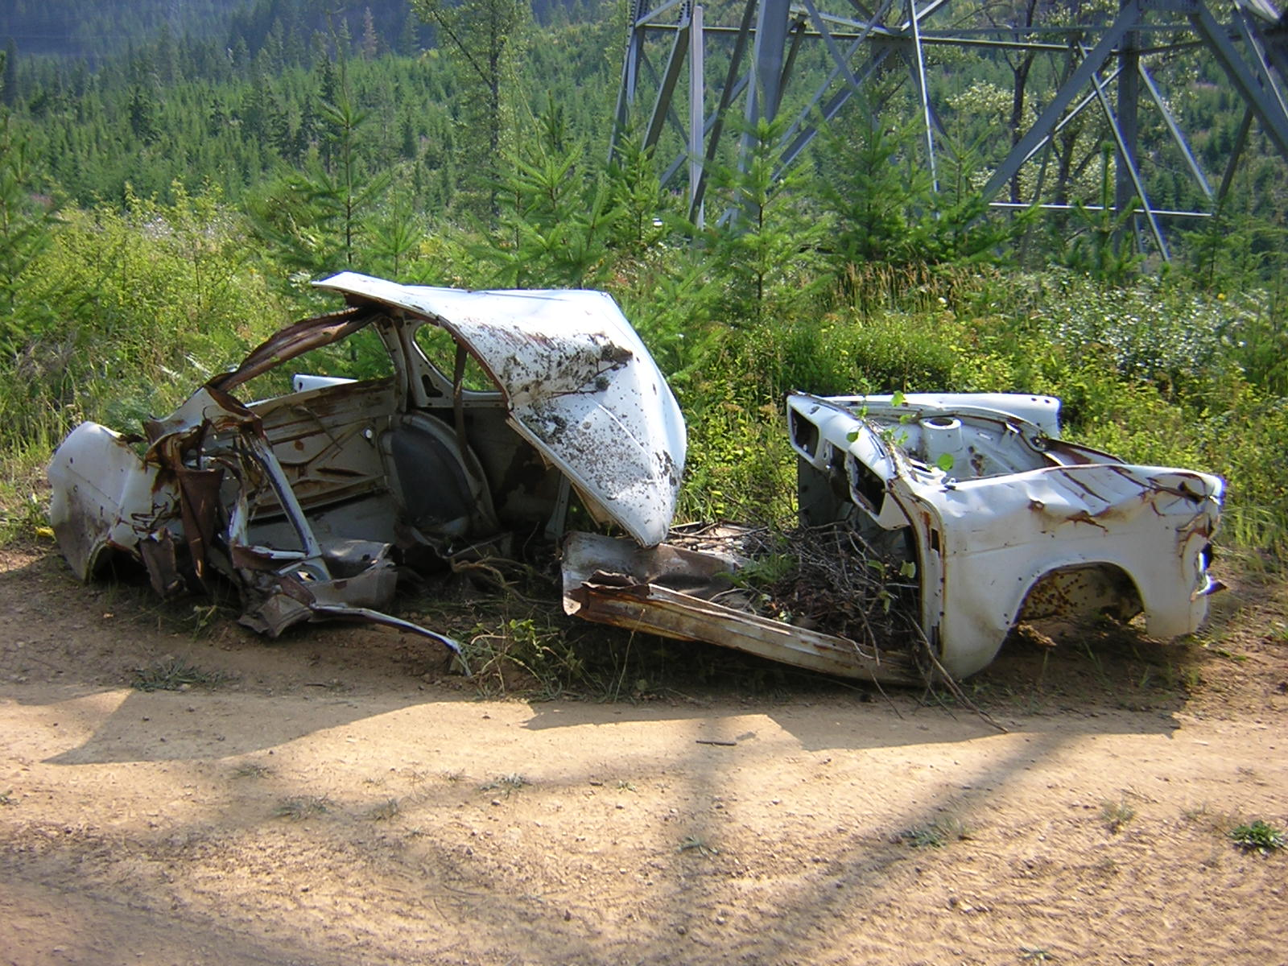
WHAT SETS US APART?
We tackle tough, remote projects that are not for the faint of heart.
  Powerline rights of way
    Magnets for trash due to almost total lack of access restrictions

Slide 49
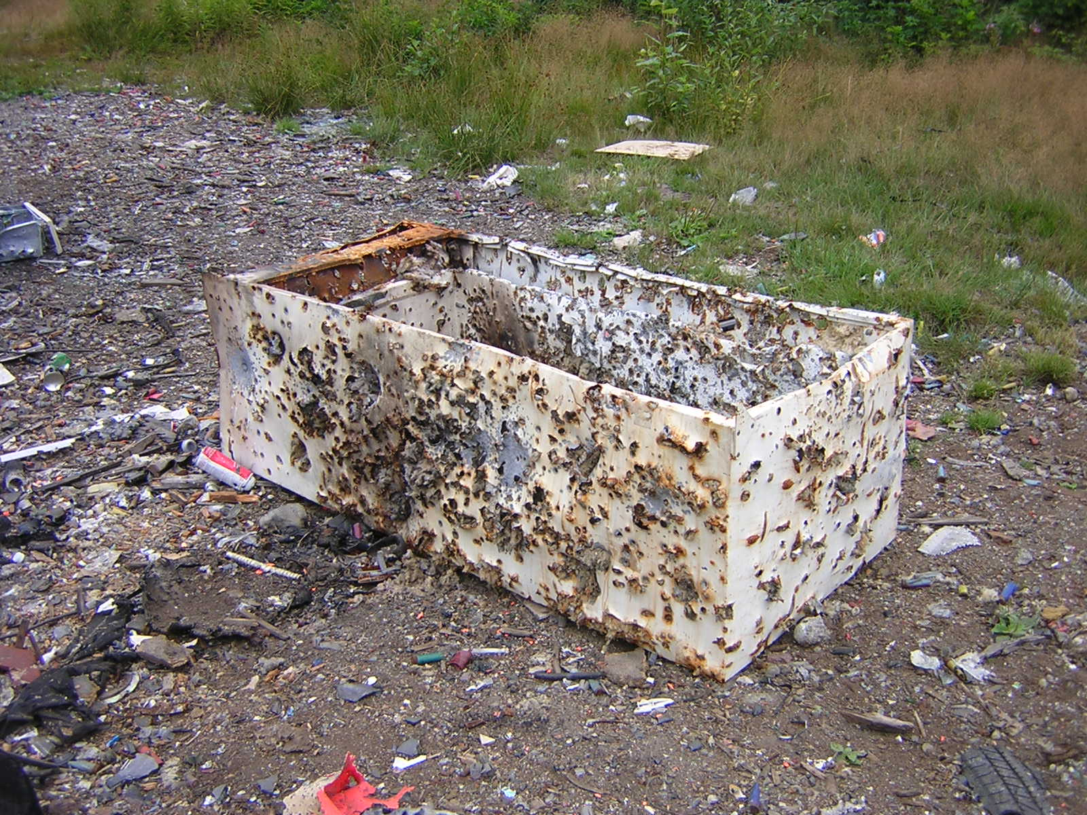
WHAT SETS US APART?
We tackle tough, remote projects that are not for the faint of heart.
  Shooting pits

Slide 50
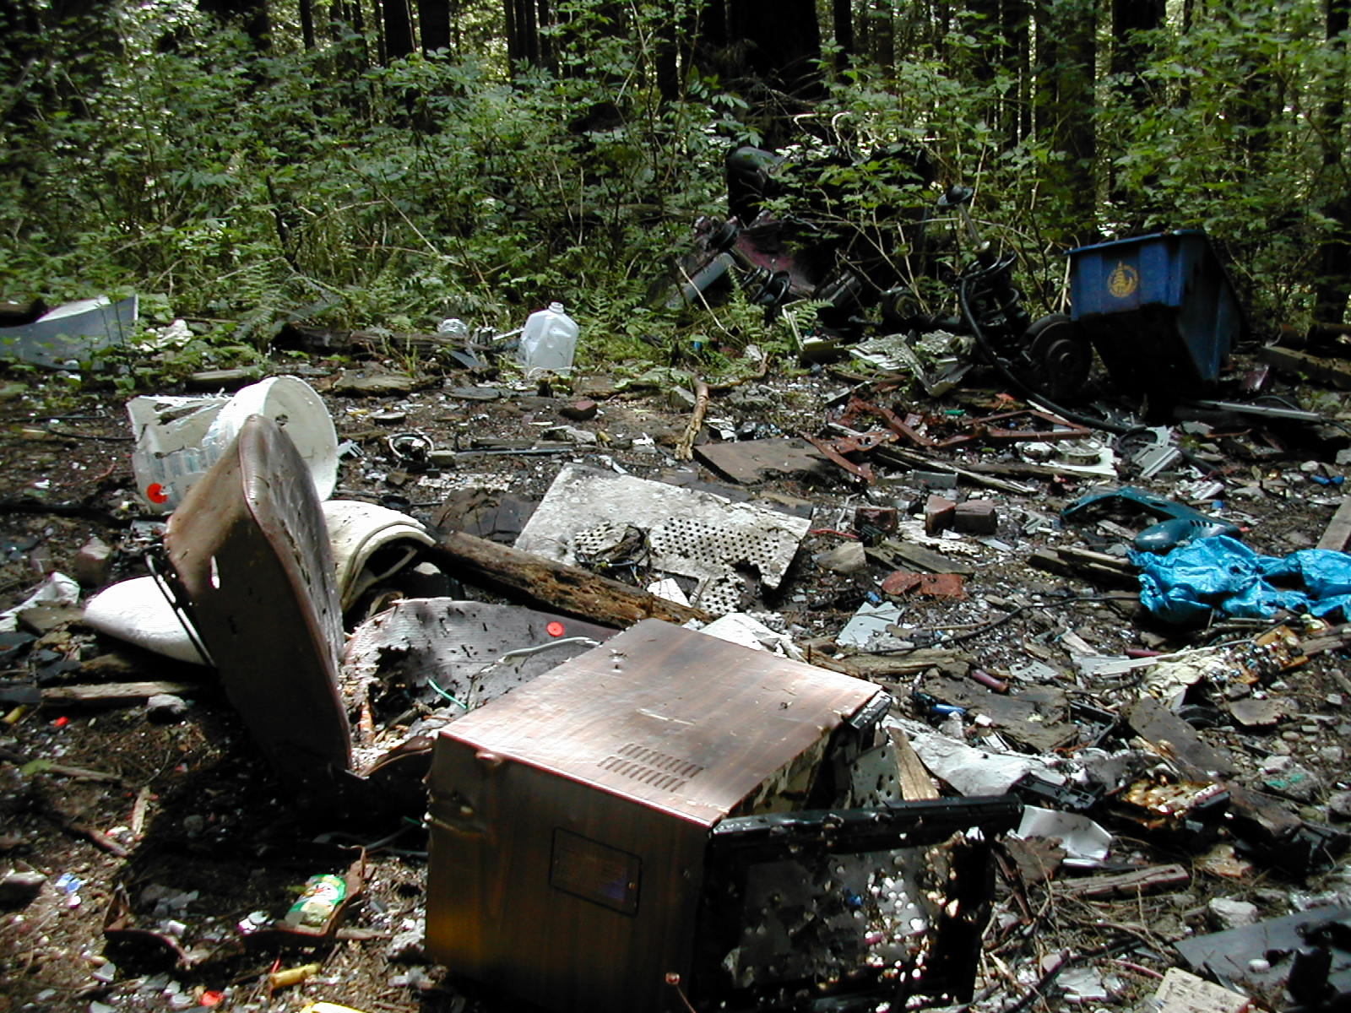
WHAT SETS US APART?
We tackle tough, remote projects that are not for the faint of heart.
  Shooting pits

Slide 51
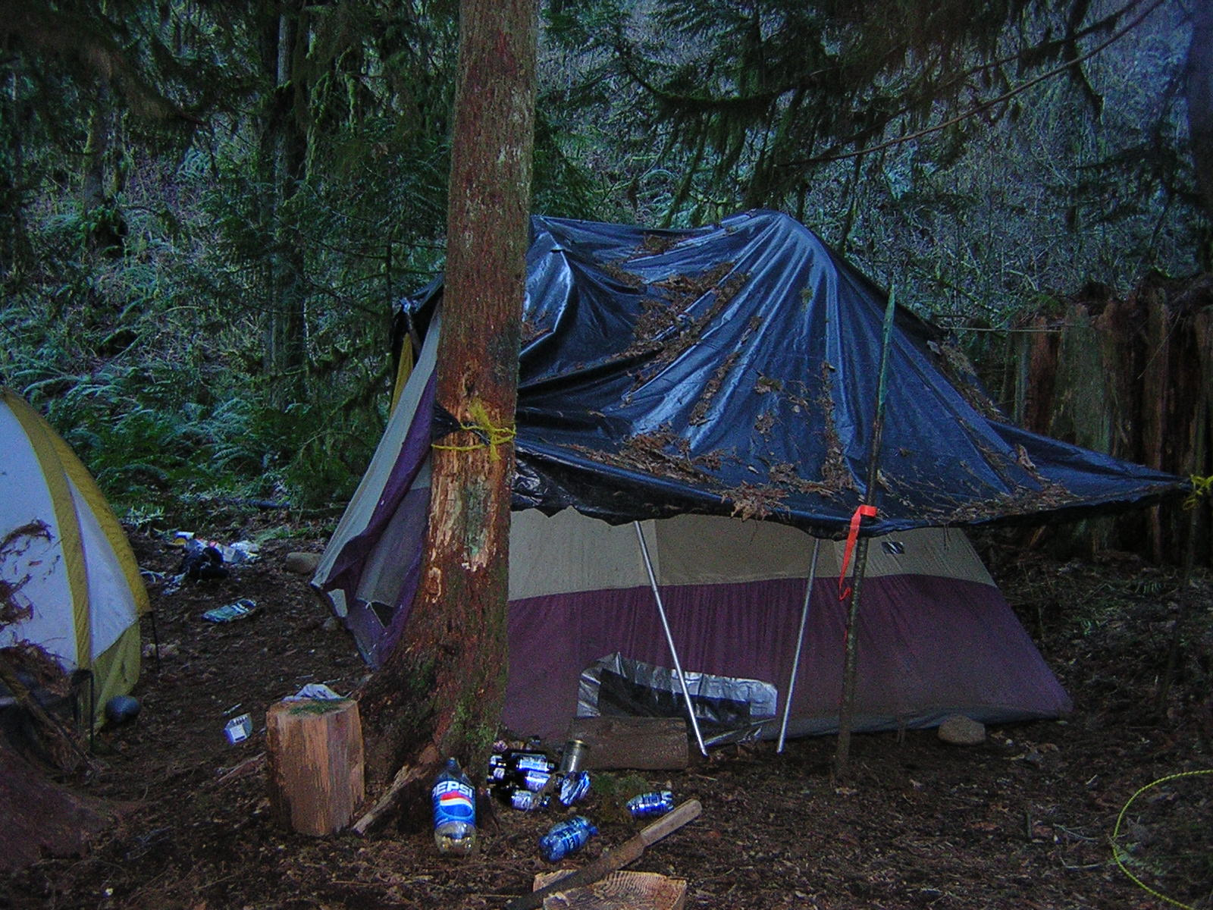
WHAT SETS US APART?
We tackle tough, remote projects that are not for the faint of heart.
  Abandoned campsites

Slide 52
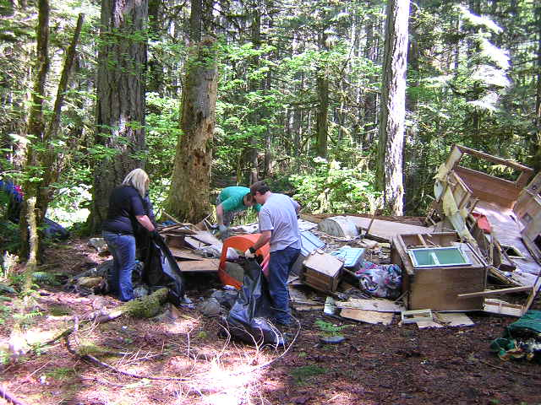
WHAT SETS US APART?
We tackle tough, remote projects that are not for the faint of heart.
  Abandoned campsites

Slide 53
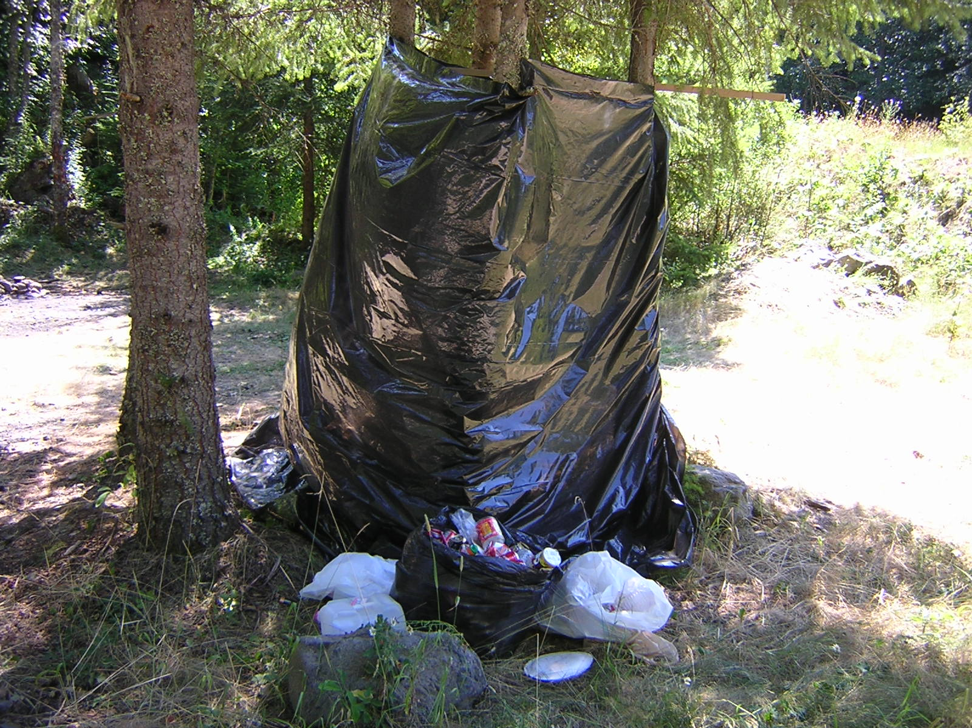
WHAT SETS US APART?
We tackle tough, remote projects that are not for the faint of heart.
  Makeshift outhouses

Slide 54

WHAT SETS US APART?
We tackle tough, remote projects that are not for the faint of heart.
  Abandoned party sites

Slide 55

WHAT SETS US APART?
We tackle tough, remote projects that are not for the faint of heart.
  Abandoned campers

Slide 56

WHAT SETS US APART?
We tackle tough, remote projects that are not for the faint of heart.
  Abandoned trailers

Slide 57

WHAT SETS US APART?
We tackle tough, remote projects that are not for the faint of heart.
  Abandoned trailers

Slide 58

WHAT SETS US APART?
We tackle tough, remote projects that are not for the faint of heart.
  Abandoned trailers

Slide 59

WHAT SETS US APART?
We tackle tough, remote projects that are not for the faint of heart.
  Abandoned trailers

Slide 60

WHAT SETS US APART?
We tackle tough, remote projects that are not for the faint of heart.
  Abandoned vehicles

Slide 61

WHAT SETS US APART?
We tackle tough, remote projects that are not for the faint of heart.
  Abandoned vehicles

Slide 62

WHAT SETS US APART?
We tackle tough, remote projects that are not for the faint of heart.
  Abandoned vehicles

Slide 63

WHAT SETS US APART?
We tackle tough, remote projects that are not for the faint of heart.
  Abandoned vehicles

Slide 64

WHAT SETS US APART?
Not everything we find is on flat, level ground.

Slide 65

WHAT SETS US APART?
Not everything we find is on flat, level ground.

Slide 66

WHAT SETS US APART?
Not everything we find is on flat, level ground.

Slide 67

WHAT SETS US APART?
Not everything we find is on flat, level ground.

Slide 68

WHAT SETS US APART?
Not everything we find is on flat, level ground.
Some of it is rusted and covered with moss, logs, branches and leaves and has been there for decades.

Slide 69

WHAT SETS US APART?
Not everything we find is on flat, level ground.
Or it may not be on the ground at all.

Slide 70

WHAT SETS US APART?
Not everything we find is on flat, level ground.
Or it may not be on the ground at all.
But that doesn’t stop us from going the extra mile.

Slide 71

WHAT SETS US APART?
With large objects in the river, there may only be one way of getting them out . . .

Slide 72

WHAT SETS US APART?
. . . and helicopter rental is EXPENSIVE!!!

Slide 73

WHAT SETS US APART?
Some of our finds require creativity and a variety of methods and equipment to remove.

Slide 74

WHAT SETS US APART?
Some of our finds require creativity and a variety of methods and equipment to remove.

Slide 75

WHAT SETS US APART?
Some of our finds require creativity and a variety of methods and equipment to remove.

Slide 76

WHAT SETS US APART?
Some of our finds require creativity and a variety of methods and equipment to remove.

Slide 77

WHAT SETS US APART?
Some of our finds require creativity and a variety of methods and equipment to remove.

Slide 78

WHAT SETS US APART?
Some of our finds require creativity and a variety of methods and equipment to remove.

Slide 79

WHAT SETS US APART?
Some of our finds require creativity and a variety of methods and equipment to remove.

Slide 80

WHAT SETS US APART?
Some of our finds require creativity and a variety of methods and equipment to remove.

Slide 81

WHAT SETS US APART?
Some of our finds require creativity and a variety of methods and equipment to remove.

Slide 82

WHAT SETS US APART?
Some of our finds require creativity and a variety of methods and equipment to remove.

Slide 83

WHAT SETS US APART?
Some of our finds require creativity and a variety of methods and equipment to remove.

Slide 84

WHAT SETS US APART?
Some of our finds require creativity and a variety of methods and equipment to remove.

Slide 85

WHAT SETS US APART?
Some of our finds require creativity and a variety of methods and equipment to remove.

Slide 86

WHAT SETS US APART?
Some of our finds require creativity and a variety of methods and equipment to remove.

Slide 87
THE BOTTOM LINE
We are the only group in Washington that is willing to tackle projects of this nature.

Slide 88
THE BOTTOM LINE
If we didn’t take care of these areas, no one else would.
We are the last hope for these areas.

Slide 89
What YOU CAN do
PLEASE CONSIDER SUPPORTING US AND HELPING US TURN THIS . . .

Slide 90
What YOU CAN do
PLEASE CONSIDER SUPPORTING US AND HELPING US TURN THIS . . .
. . . BACK INTO THIS.
THANK YOU ! ! !

Slide 91
FRIENDS OF THE TRAIL
A nonprofit organization dedicated to cleaning up Washington’s public lands and waterways
PO Box 1124
North Bend, WA 98045
Phone/Fax: 425-831-5486
Email: friendsot@comcast.net
www.friendsofthetrail.org

